Slide 1

Trash, Recycle, Compost:
Getting Campus Waste Right

Slide 2
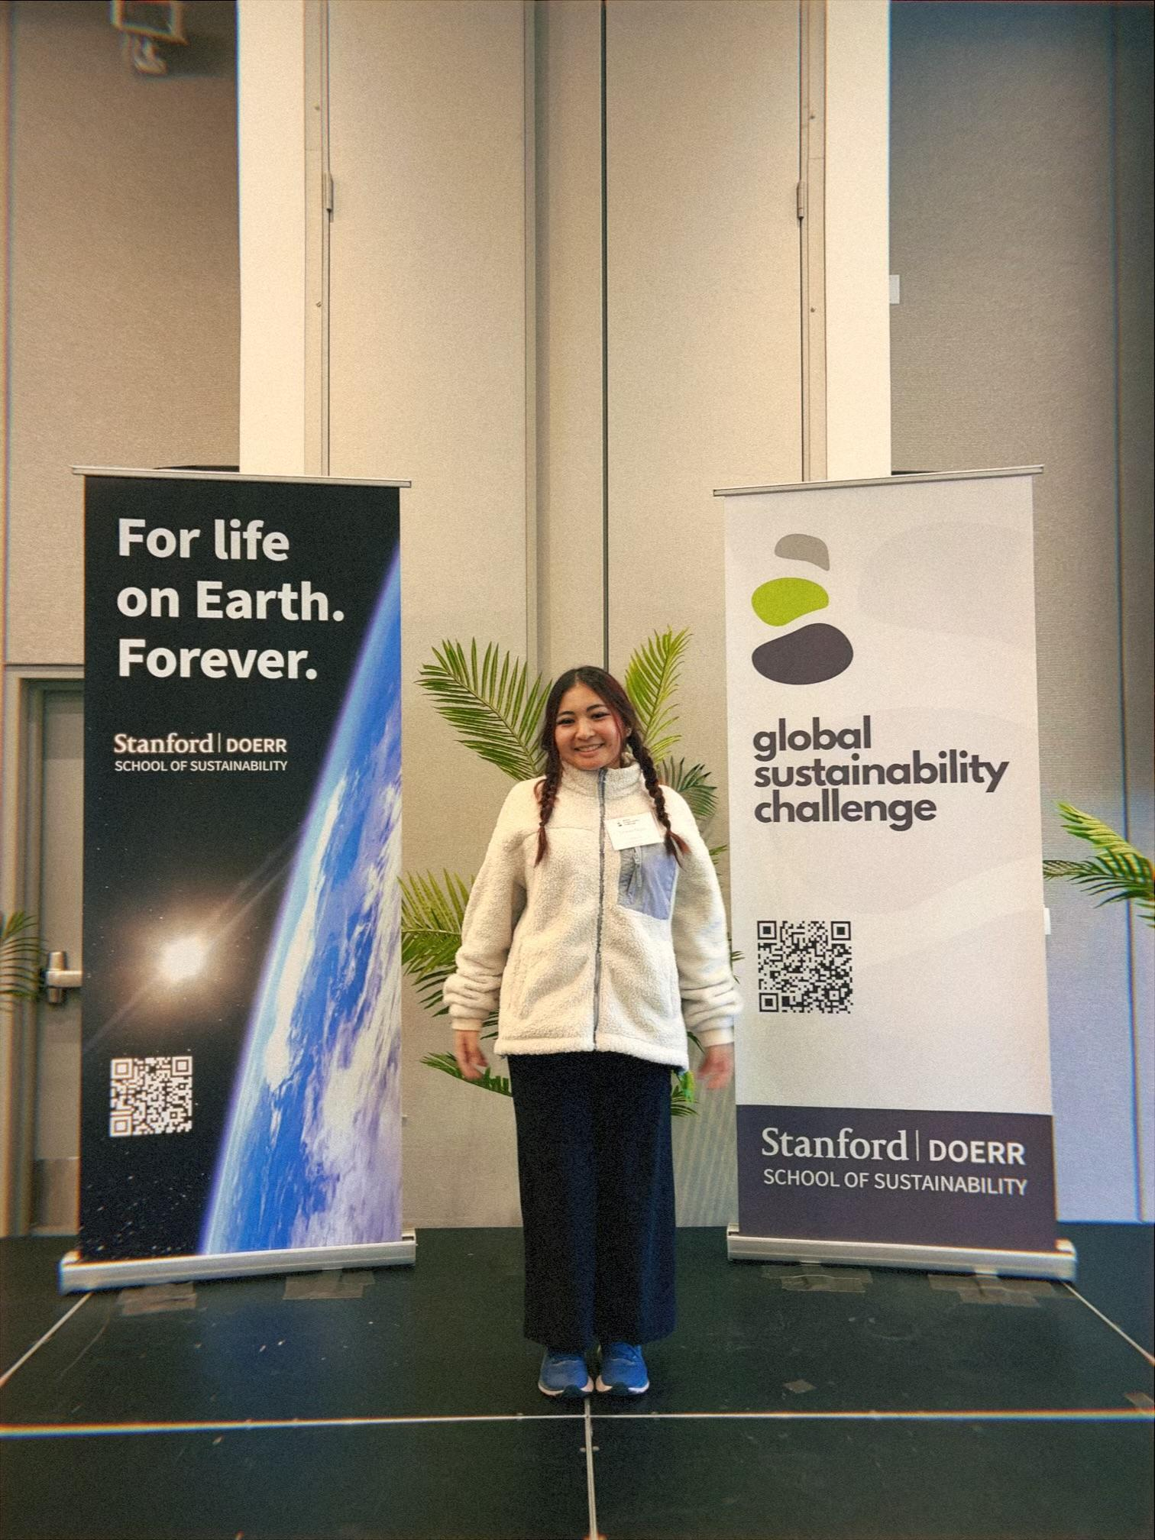
TRINIE NGO
Chancellor’s Student Climate Fellow- Riverside City College
Notes:
2 minutes

Slide 3
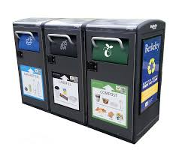
OBJECTIVE OF PROJECT
-Currently working on a better waste management system (recycling, trash, and compost).
-Further educate students on proper waste sorting practices to reduce food waste.

Slide 4
RIVERSIDE CITY COLLEGE
California Assembly Bill 341: California Law regarding recycling that applies to businesses and apartment complexes.
California Senate Bill 1383: California Law about separating food/organic waste and reducing food waste.
Notes:
2 minutes

Slide 5


Please fill out the form!
https://docs.google.com/forms/d/1q850XvdXnTUYjTck9-YPW2NgFBdRKm8xf-JhCuXn_E8/edit#responses
Notes:
8 minutes

Slide 6
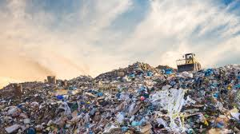
Did you know…
“Composting organic waste versus landfilling it can reduce more than 50% of carbon dioxide-equivalent greenhouse gas emissions” (Sustainable Composting Research at Princeton (S.C.R.A.P. LAB Princeton).
Notes:
2 minutes

Slide 7

What goes where?! Trash, recycling & composting
https://www.youtube.com/watch?v=StuuSArAxnk (4 minutes)
Notes:
4 minutes + 4 minutes of questions

Slide 8
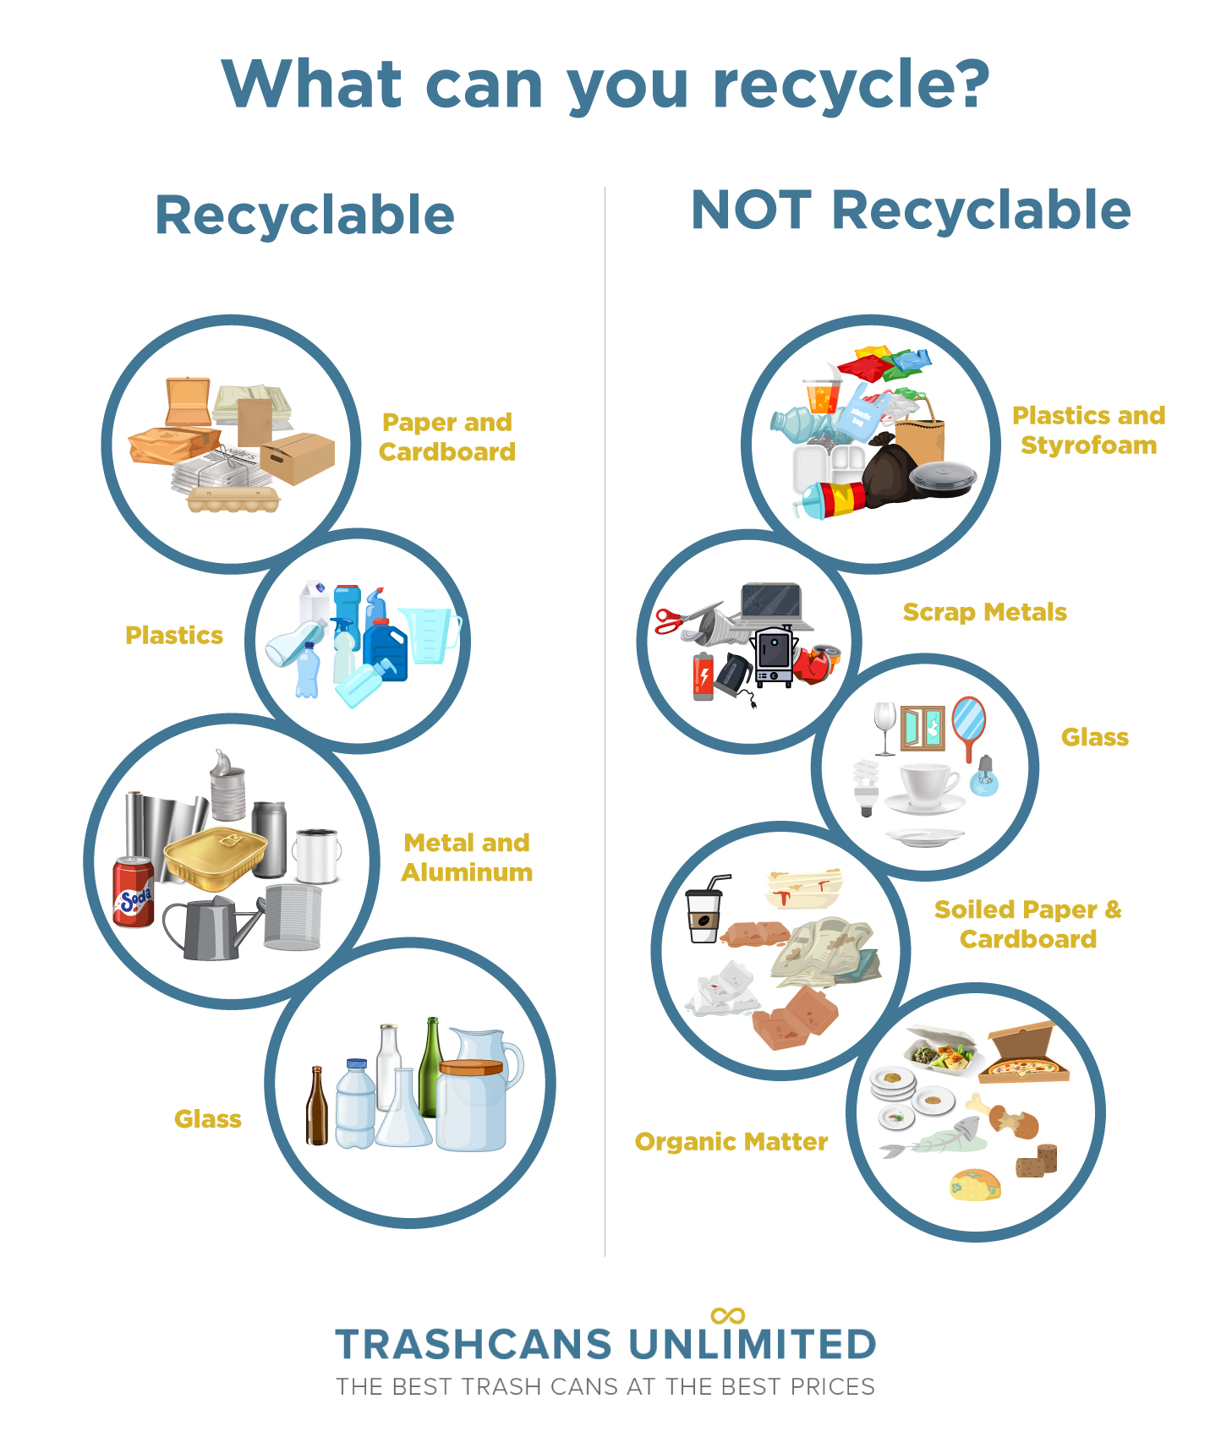
RECYCLE
Clean/dry bottles, cans, paper

Slide 9
WHAT IS RECYCLING
Process of collecting, sorting, and processing discarded waste materials and remanufacturing them in new, usable products
BENEFITS:
-Conserves natural resources
-Saves Energy
-Reduces Greenhouse Gas Emissions
-Prevents Landfill Waste
-Strengthens the Economy with jobs

Slide 10
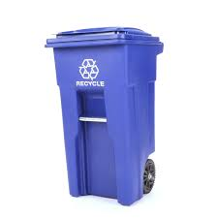
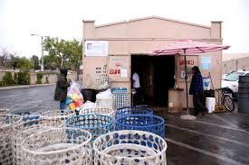
DIFFERENT RECYCLING
BLUE RECYCLING BINS
BUY-BACK CENTERS
CRV (California Redemption Value): deposit fee consumers pay when purchasing eligible beverages California

Slide 11
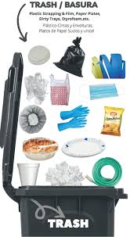
TRASH
Everything Else

Slide 12
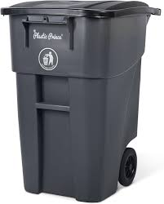
WHAT IS TRASH
Unwanted, discarded materials or waste including everyday items
BENEFITS of PROPER DISPOSAL:
-Pest Control
-Public Safety and prevents hazardous items cluttering streets, parks, and pathways
-Pollution prevention of chemicals and toxins in local water supplies and the environment
-Beautiful and Clean Communities

Slide 13
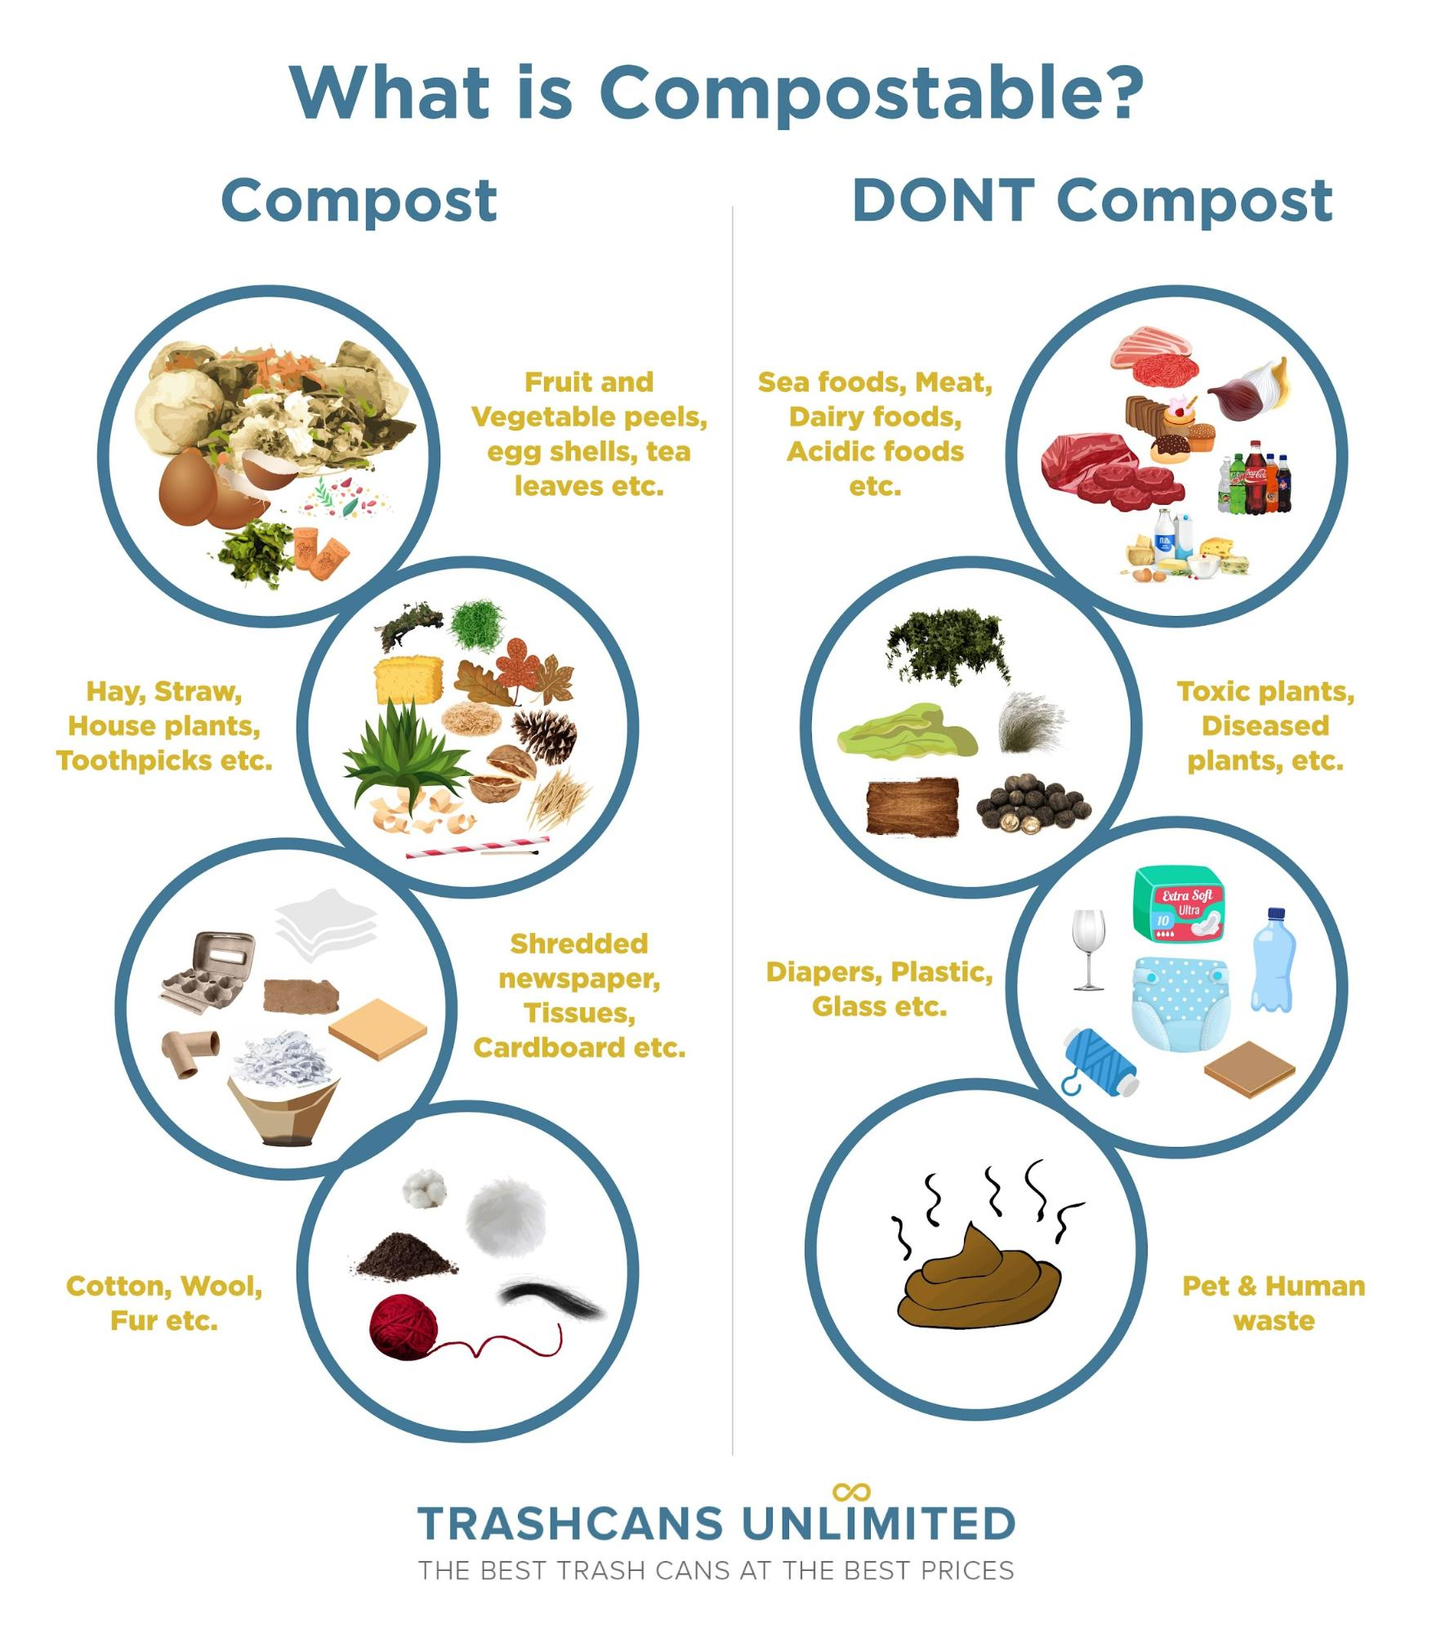
COMPOST
Food Scraps and Yard Waste

Slide 14
WHAT IS COMPOSTING
Helps with sustainability and helps the environment by turning food waste into soil that can be reused as nutrient-rich soil instead of harmful gases.
BENEFITS:
-less methane leads to less heat trapped in the atmosphere
-add nutrients that assist with plant growth
-limits trash in landfills

Slide 15
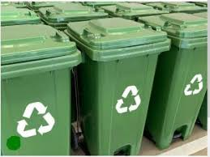
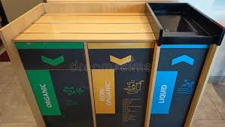
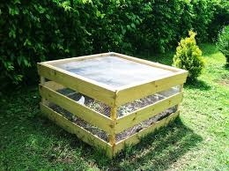
DIFFERENT COMPOSTING
GREEN BINS OUTSIDE/ HOME
AT HOME COMPOSTING
RESTAURANT:

Slide 16
DIFFERENT FORMS OF COMPOSTING
Micro/ Indoor -Jar Composting -Worm Bins (Vermicomposting)
Individual Outdoor -Backyard Bins & Tumblers -Trench Composting
Community/ Municipal -Community/ Org Volunteering -Green Bins (Industrial)
Notes:
10 minutes

Slide 17
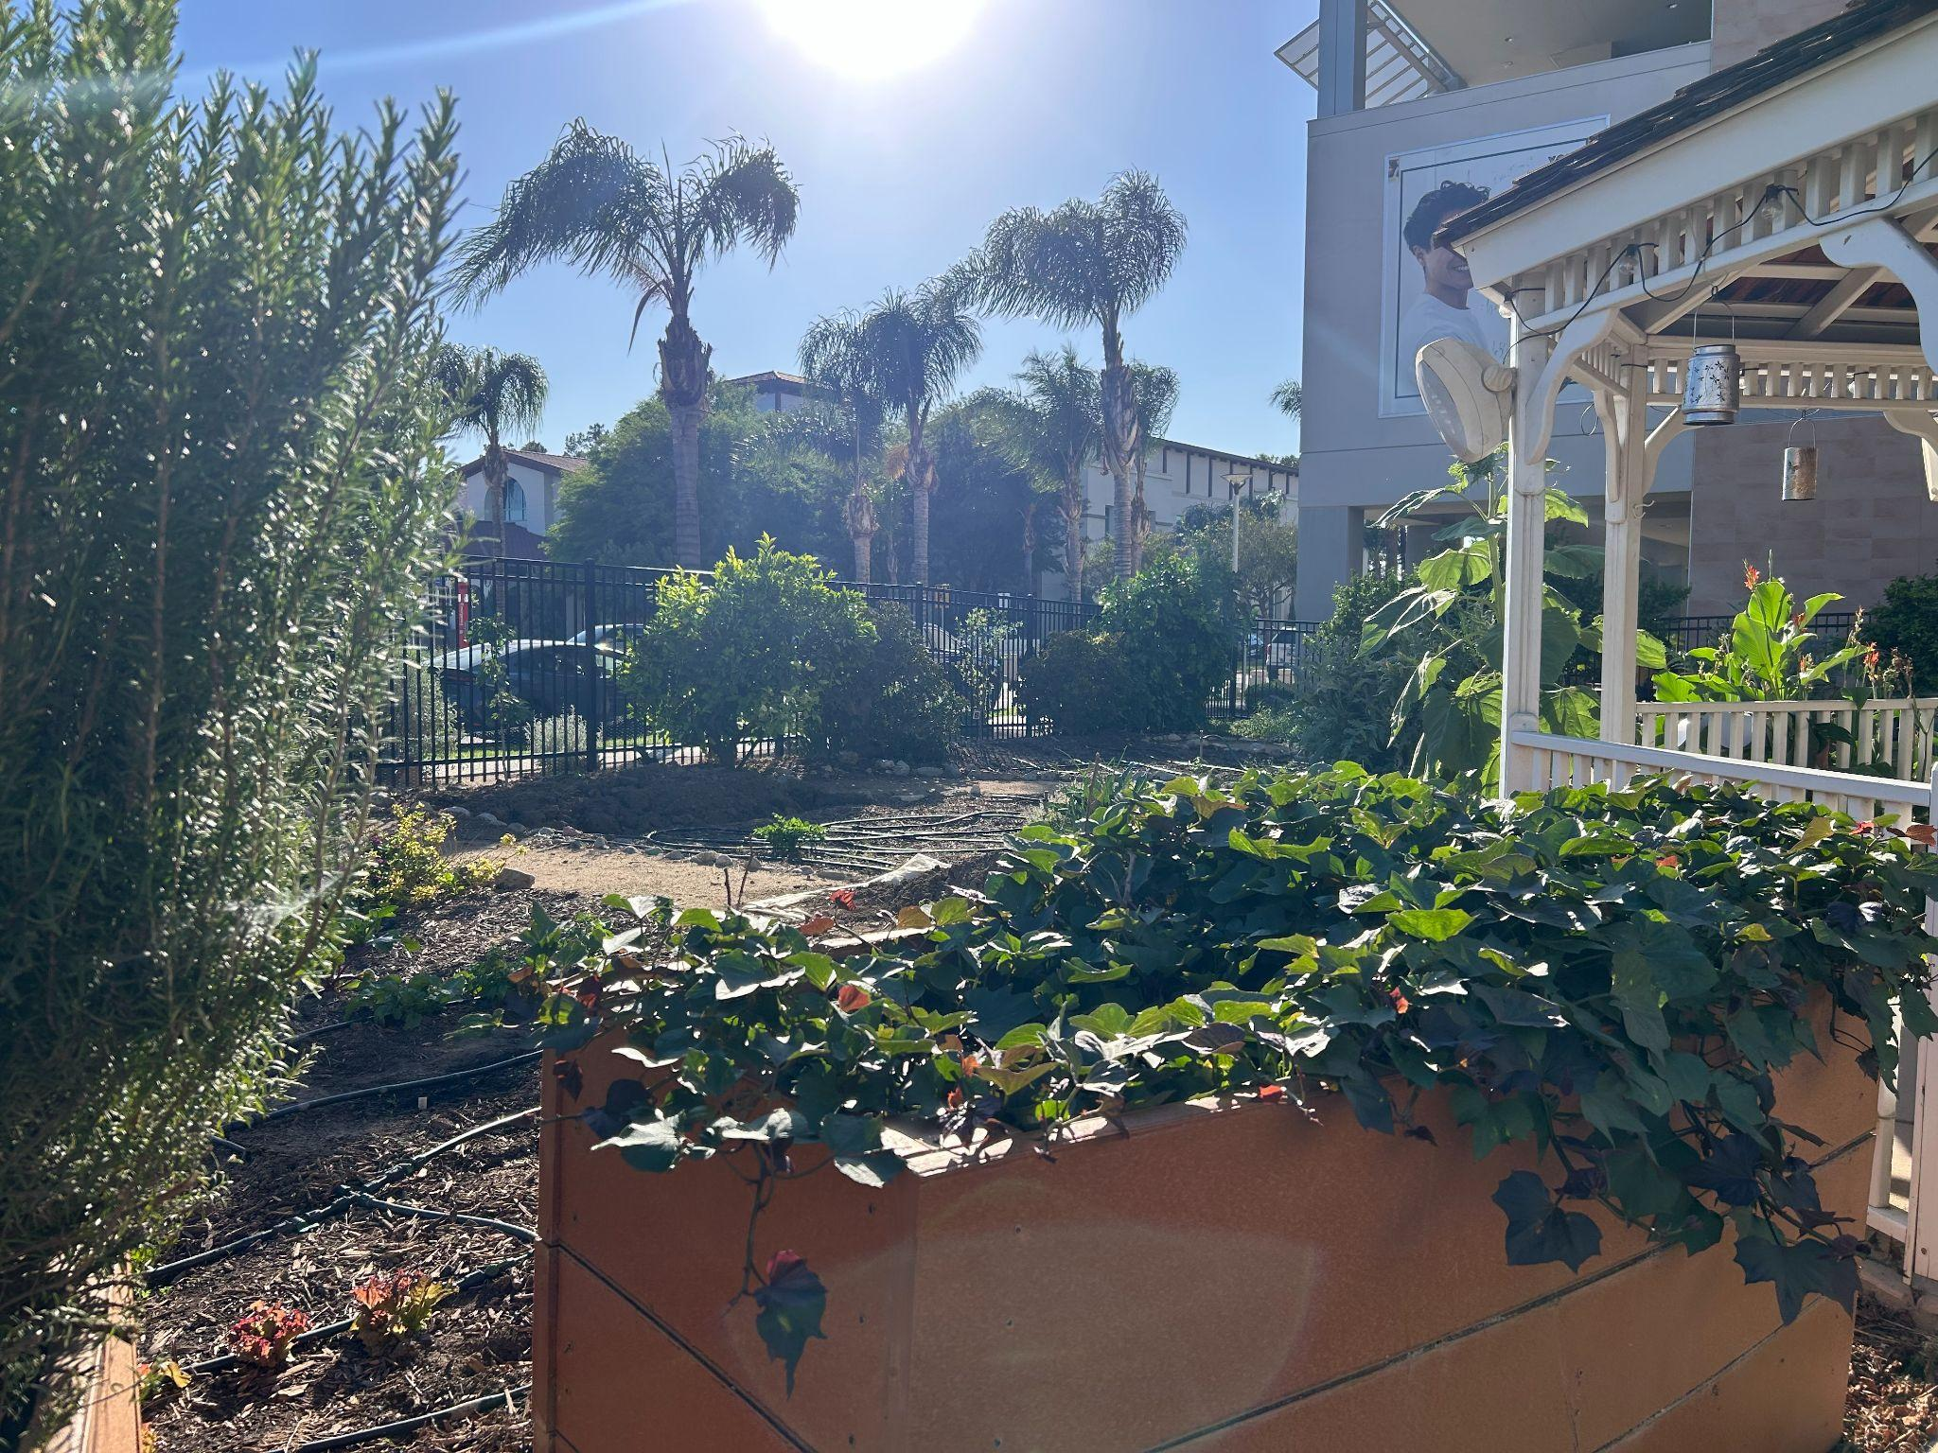
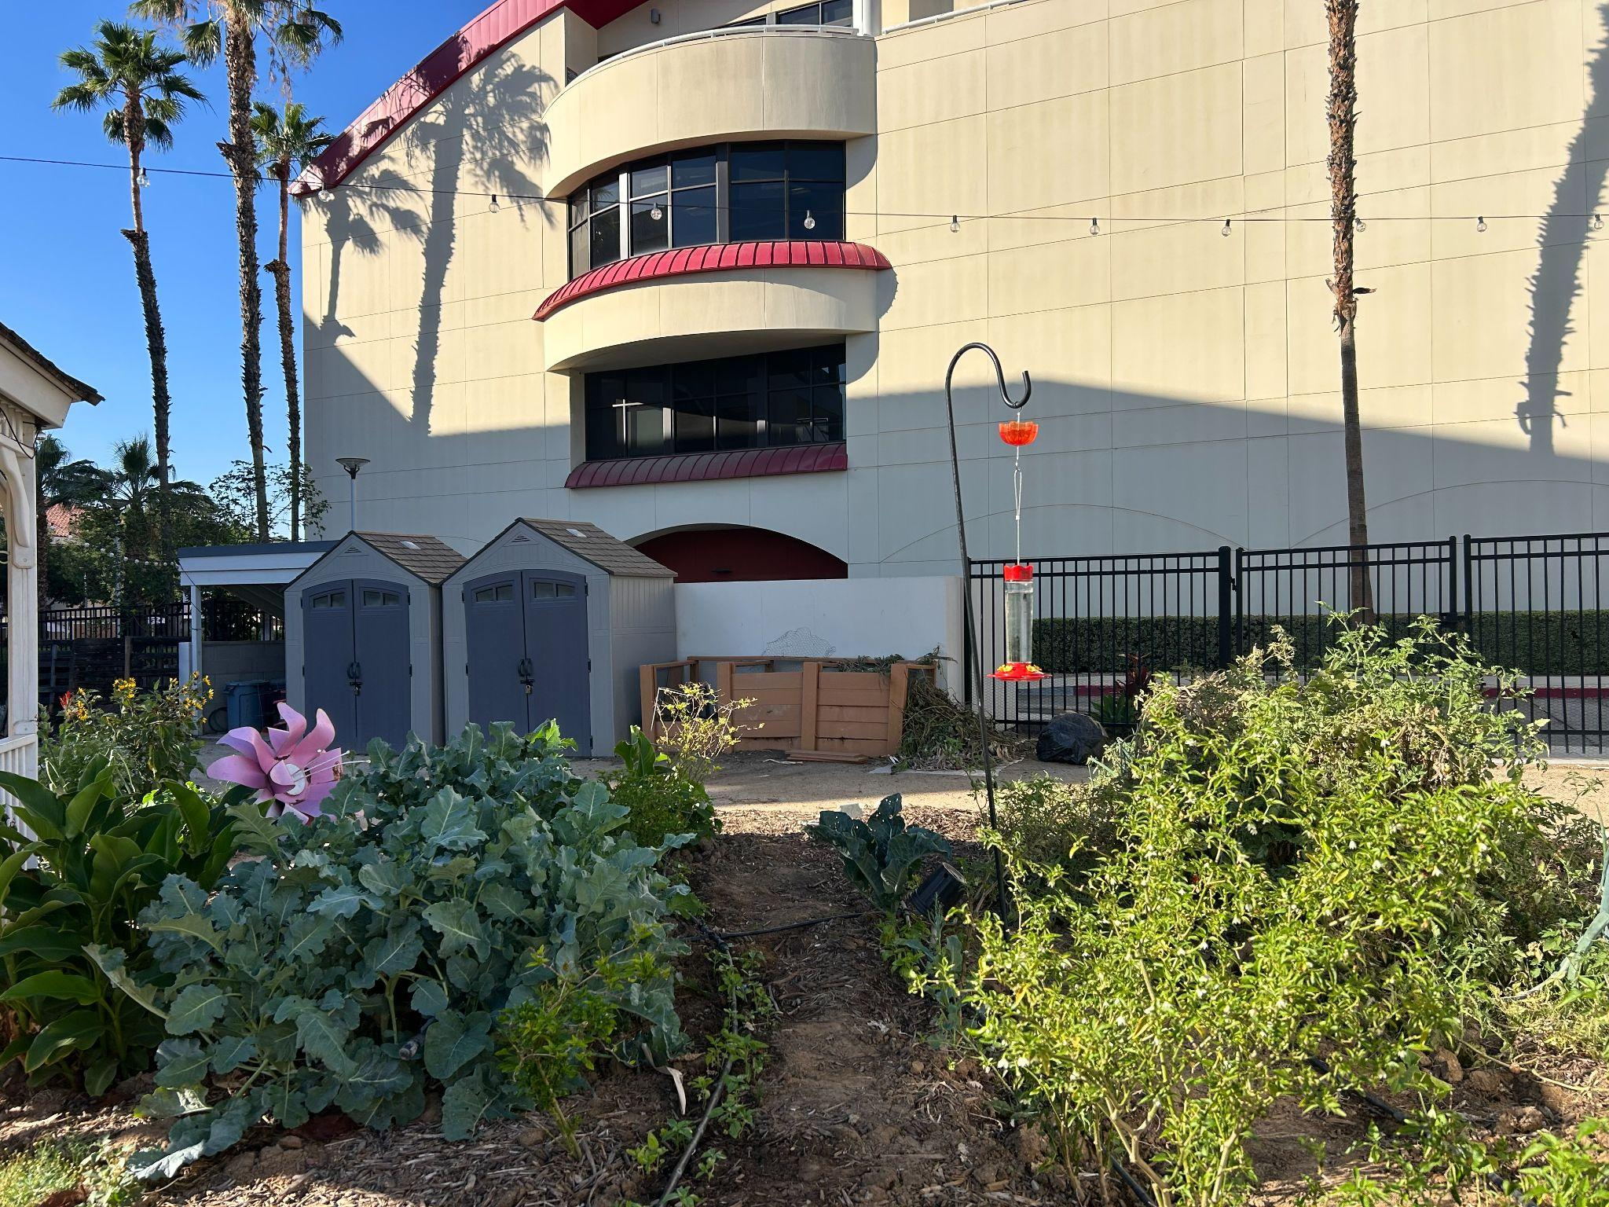
SPORES LAB
1800 sq ft
backyard scale
Sustainable
Plant
Operations
Research &
Environmental
Stewardship
volunteer hours 2X per week
Notes:
15 minutes for Professor Galusky to speak

Slide 18
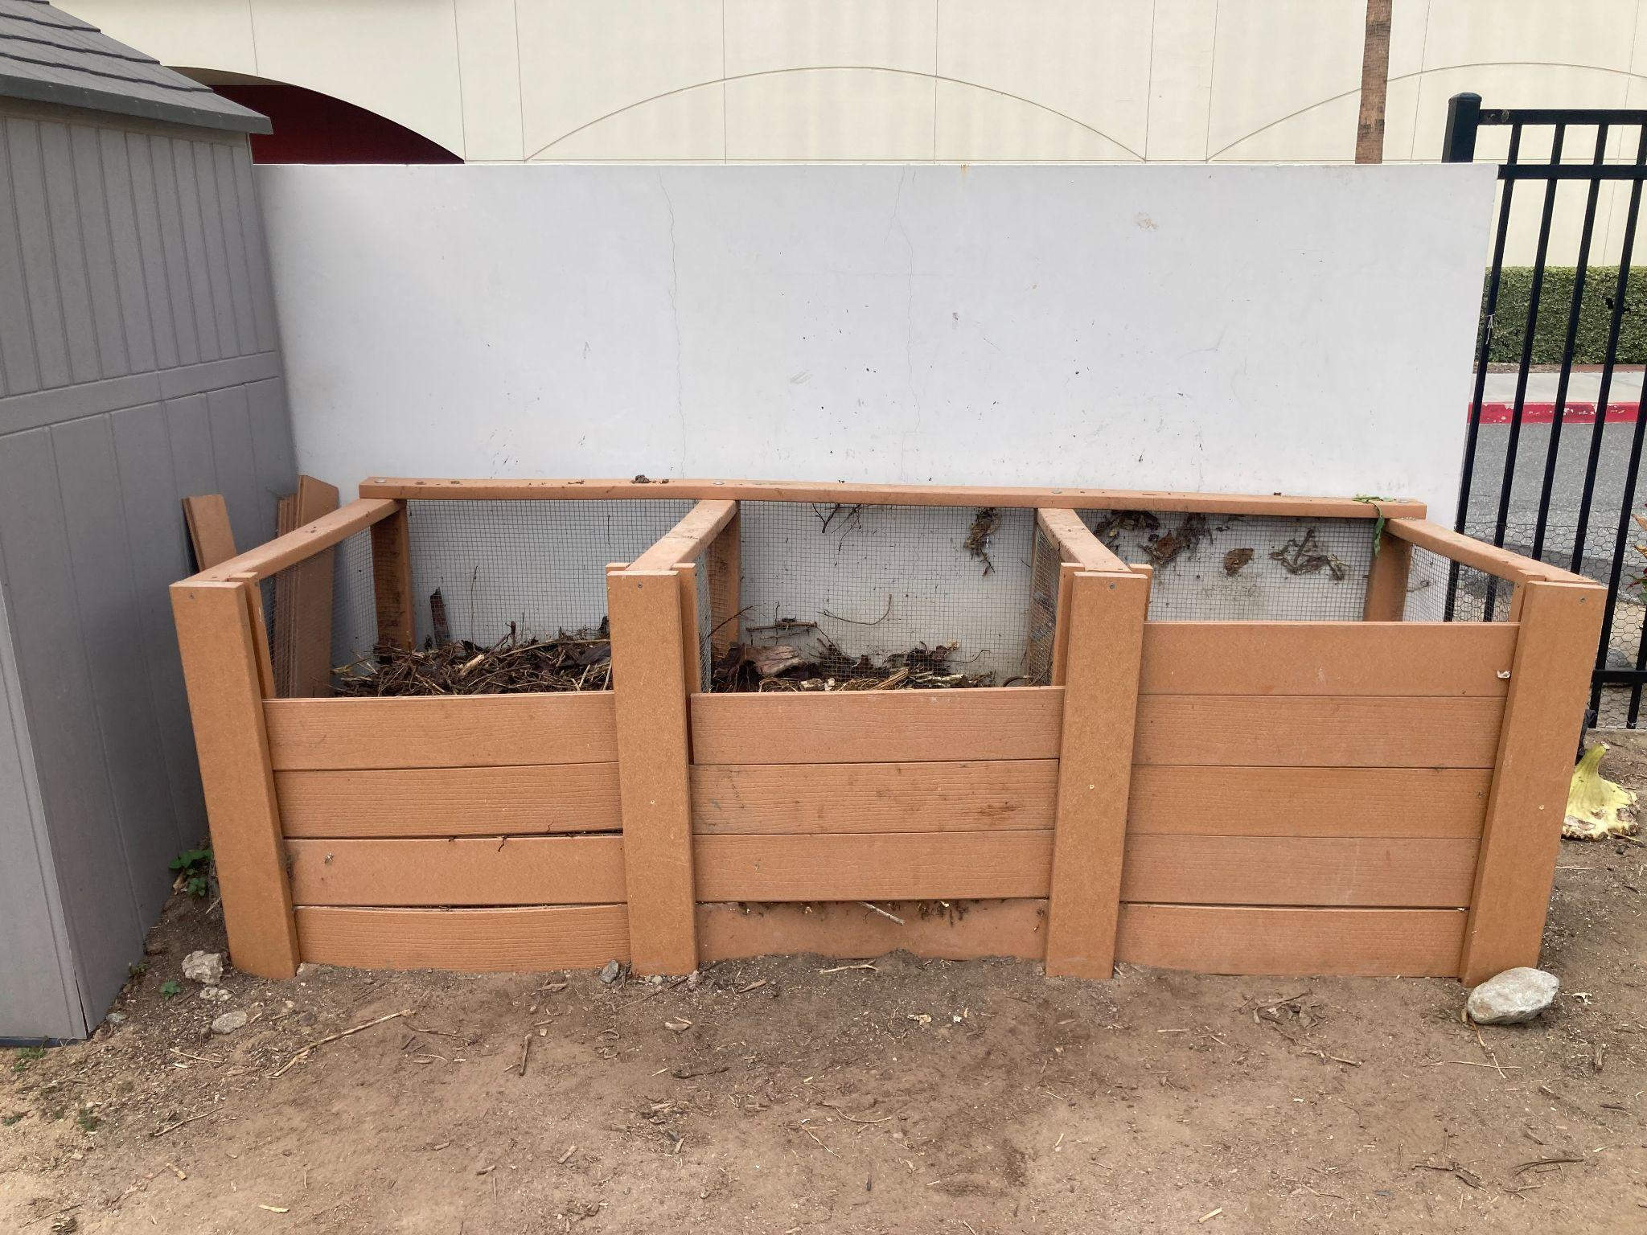
SPORES LAB - Backyard Scale
Three Bin System
  1 cubic yard each
  Fresh material added and turned b/n two bins
  Third bin stores ‘mature’ compost
  Hydrated regularly with harvest rinse water
Notes:
15 minutes for Professor Galusky to speak

Slide 19
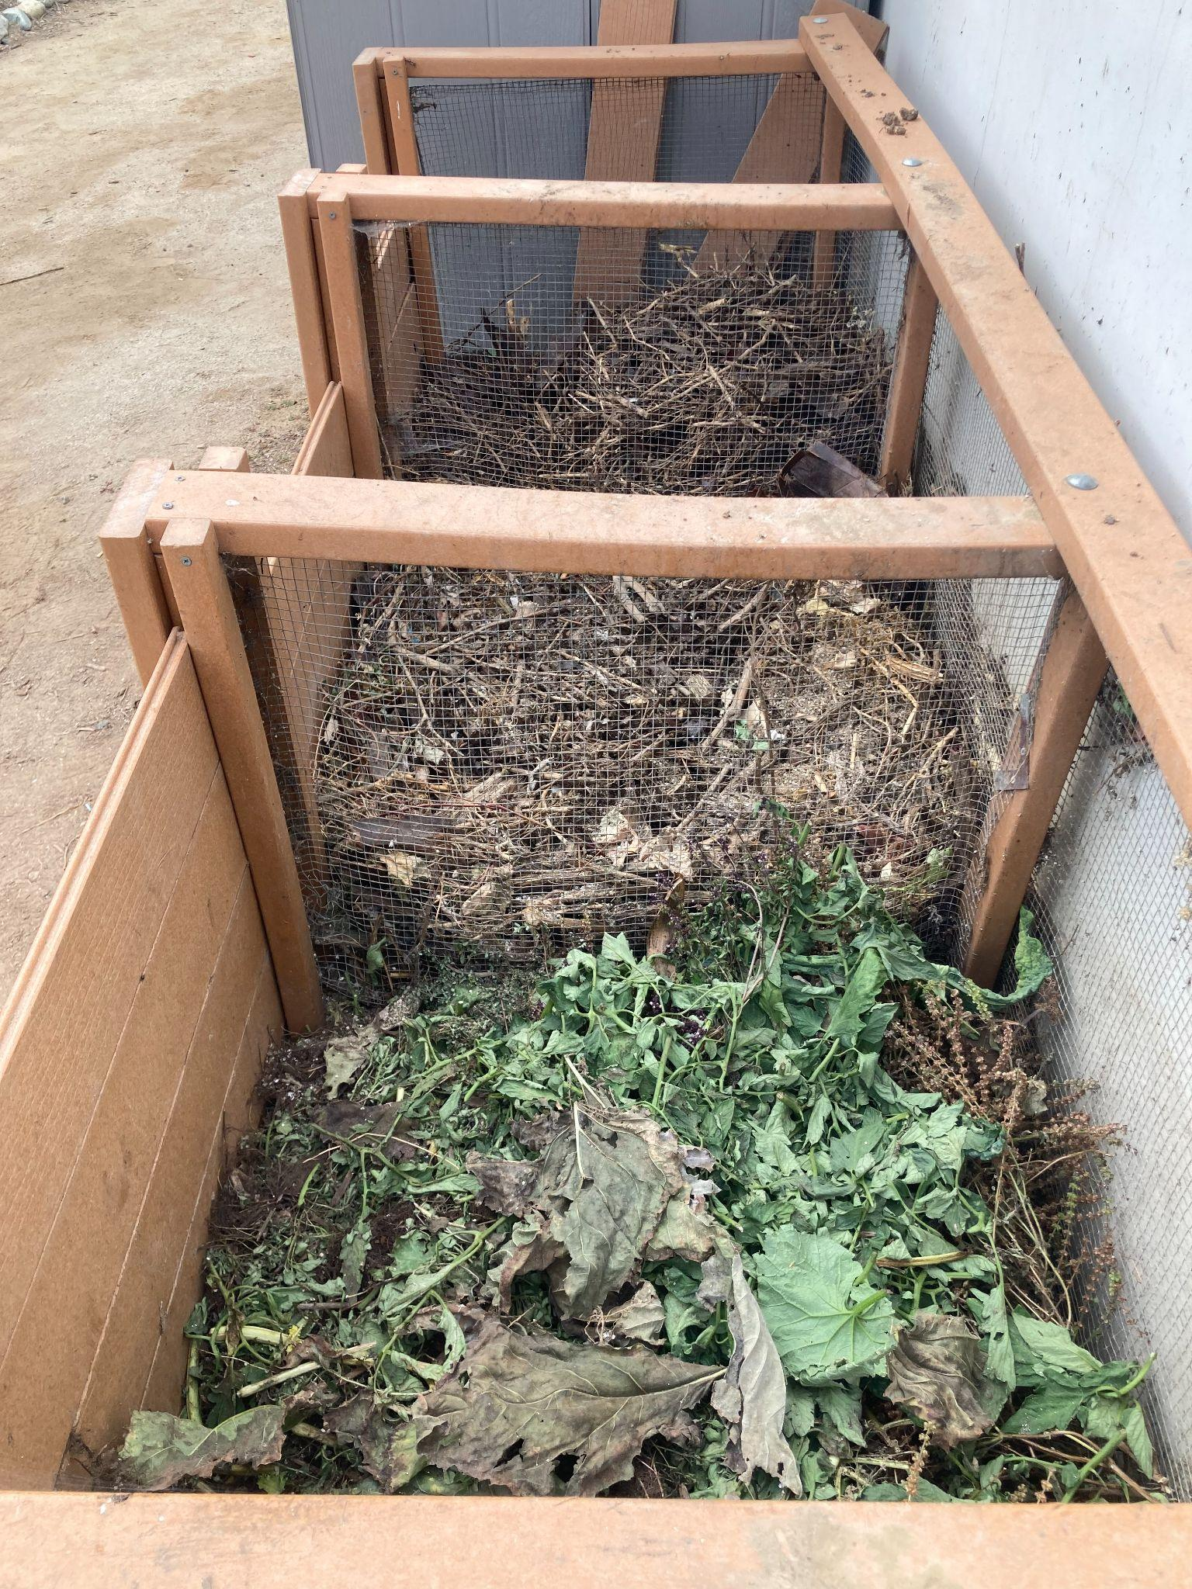
SPORES LAB - Backyard Scale
Nearly all organic waste utilized
  Weeds accepted
    No seeds is best
  Diseased and woody material diverted
Human powered!
  Chop, turn, repeat
  Difficult to keep aerobic
    Easier with more ‘browns’
    Paper or cardboard?
  More turning = faster and less smell
Notes:
15 minutes for Professor Galusky to speak

Slide 20
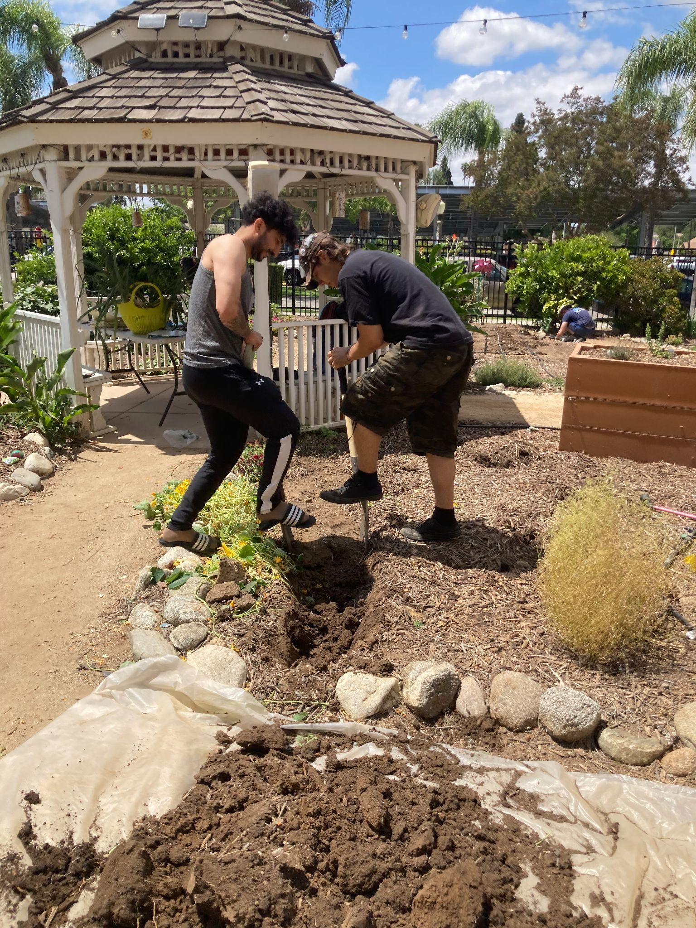
SPORES LAB - Backyard Scale
Ready in weeks to months
  Rich black color
  Earthy/pleasant smell
Applied as top dressing and soil builder
  Critical ‘double-dig’ amendment
Notes:
15 minutes for Professor Galusky to speak

Slide 21

SPORES LAB
VOLUNTEER! VOLUNTEER! VOLUNTEER! VOLUNTEER! VOLUNTEER!
VOLUNTEER ACTIVITIES:
Weed, Harvest, and Turn Compost
STAY CONNECTED -> INSTAGRAM PAGE:
-RCCSPORES
VOLUNTEER HOURS:
Wednesdays and Sundays: 8am to 10am
VOLUNTEER! VOLUNTEER! VOLUNTEER! VOLUNTEER! VOLUNTEER!

Slide 22
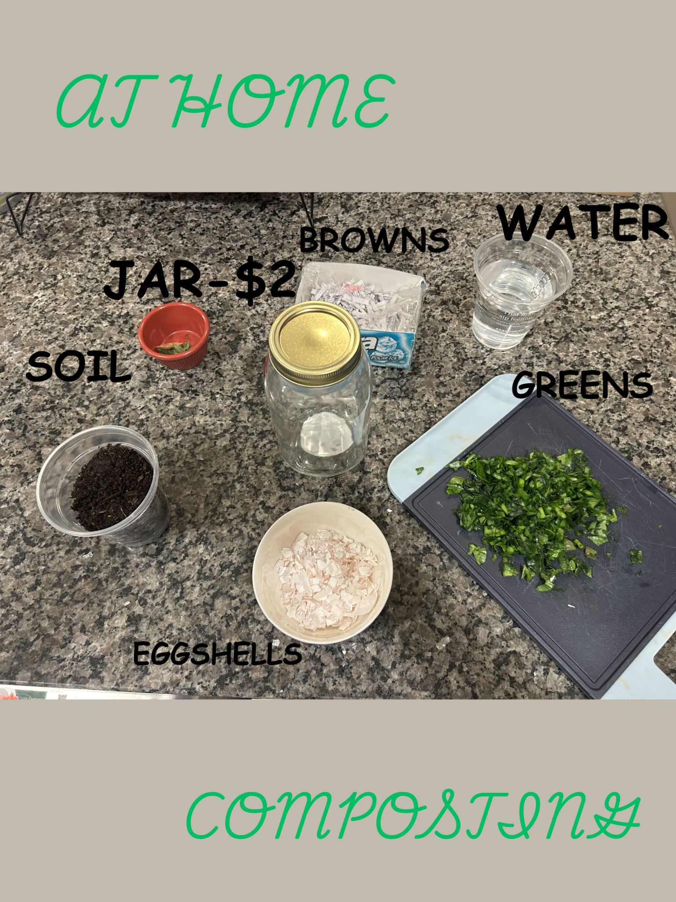
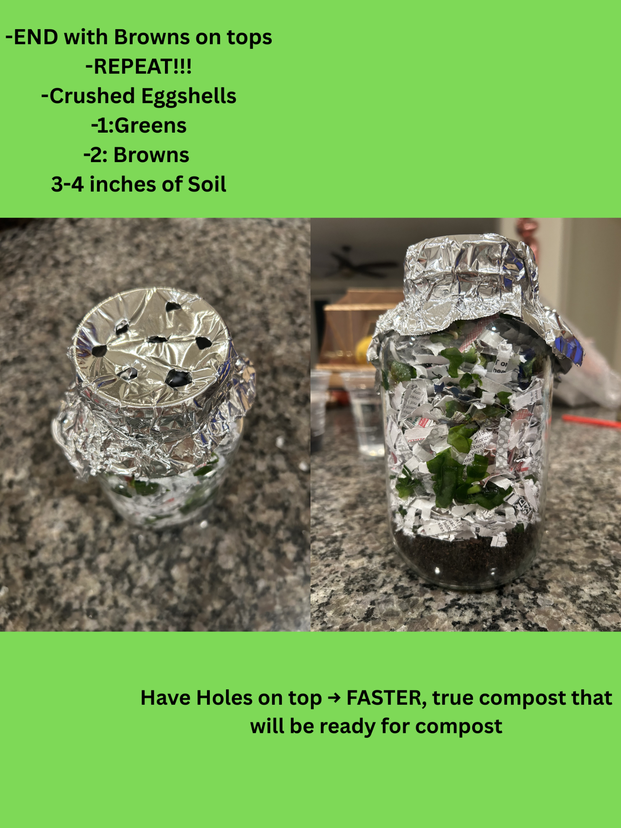
Notes:
Interactive Portion 10-15 minutes

Slide 23
RESOURCES
Riverside City County Waste Resources
https://rcwaste.org/
-A local government agency that manages all trash, recycling, and composting systems in Riverside County. Programs, such as recycling, composting, hazardous waste disposal, and community cleanups.
UC Master Gardener
https://ucanr.edu/program/uc-master-gardener-program
-Volunteer and educational outreach network run by University of California Agriculture and Natural Resources.
Keep Riverside Clean and Beautiful
https://www.krcb.com/
-A community nonprofit focused on keeping the city clean through education, cleanups, and environmental programs.

Slide 24

THANK YOU!!!
CONTACT INFORMATION:
GMAIL: CCCClimateFellowship@gmail.com
Climate Fellows Instagram: SOCAL_CLIMATE_FELLOWS
SPORES LAB INSTAGRAM: RCCSPORES
RESOURCES:
https://www2.calrecycle.ca.gov/Docs/Web/112236
Notes:
2 minutes

