Slide 1
Click, Save, Sustain
Analyzing AI Impacts on the Environment

Slide 2

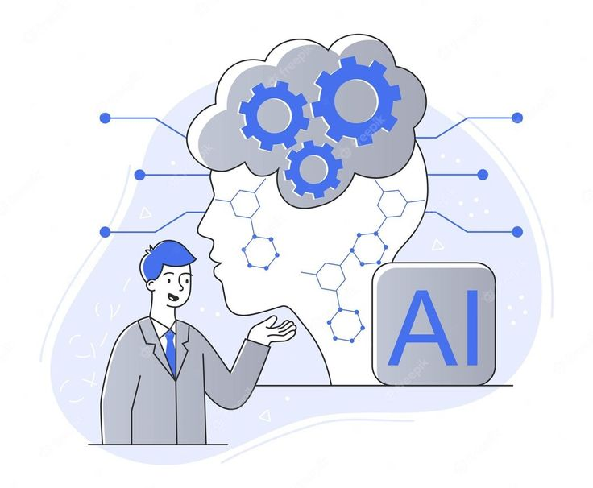
What is AI
AI is behind virtual assistants and search engines applications, but is also utilized by industries such as healthcare, finance, and transportation.
Artificial Intelligence widely known as AI comes in many forms, but specifically is technology that enables machines to perform tasks that usually require human intelligence.

Slide 3

Students’ Relationship with AI
86% to 95% of college and highschool students use AI for their coursework
Energy Consumption
Water Usage
4/10 reported feeling alarmed of the environmental impacts of AI
E-waste
Resource Extraction

Slide 4


Environmental Effects of AI
Resource Extractions:
High energy consumption
Training large AI models requires massive computational power. Data centers consume significant electricity, often powered by fossil fuels. This contributes to higher carbon emissions, especially for large scale models.
Every GPU and server requires lithium, cobalt, and rare earth elements, often mined in fragile or politically unstable regions.
Electronic waste (E-waste)
Specialized hardware requires constant upgrades.. Manufacturing and disposing of this equipment increases toxic waste,affecting ecosystems and quantity of precious resources.
Water usage
Data centers use large amounts of water for cooling servers. This can strain local water supplies, especially in drought prone regions.

Slide 5
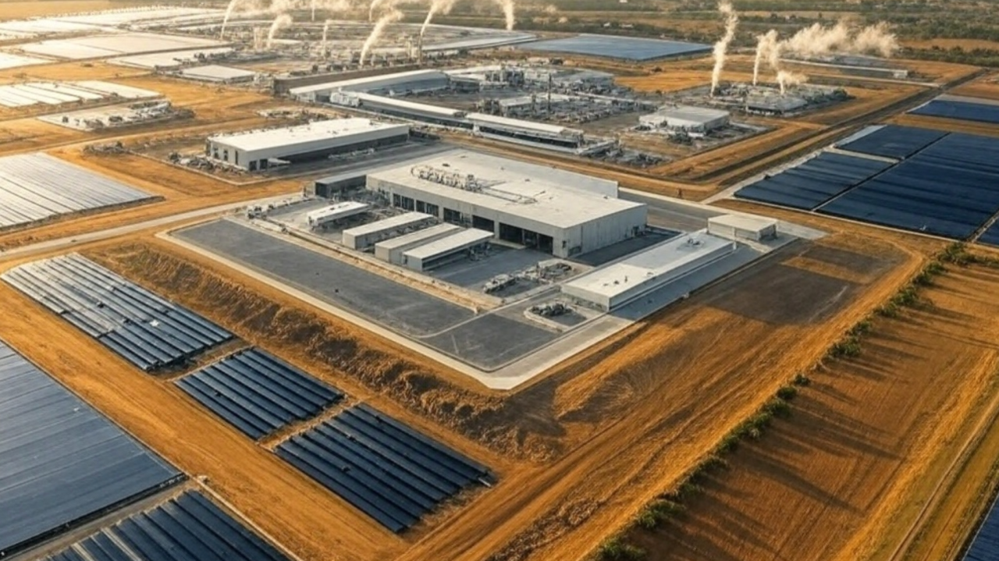
Stratos Project
The Stratos Project is a massive, multi-year energy and data center campus proposed for Box Elder County, Utah, championed by celebrity investor Kevin O’Leary.
It spans 40,000 acres in the remote Hansel Valley and has sparked intense environmental and public backlash
VS

Slide 6


How we can use AI to improve the environment
All that said AI can be used to improve the environment
It can optimize energy use in homes and power grids, improve farming by reducing water and pesticide use, monitor forests and wildlife, predict natural disasters, and reduce traffic and fuel consumption through smarter transportation systems. AI is also used to track pollution and climate change using satellite data. Although AI systems use energy themselves, they can still support environmental protection when used responsibly.

Slide 7
Should you use AI?
Is the task repetitive, data heavy or time consuming?
Do it manually
Yes
NO
Is usage of AI prohibited?
Abide by the rules
YES
No
Do not use as a crutch only a resource
Using AI for convenience or to provide real value?
convenience
Real Value
Proceed mindfully, continue to the next slide for tips

Slide 8
Only run AI tools when necessary avoid excessive or repeated queries.
Protect Learning, Creativity & Skills
Try first without AI, then compare Use AI to critique or improve your work, not replace it
Pause for 10 seconds and ask:
Do I actually need AI for this? Is there a simpler tool (notes, search, calculator, template)? Am I using AI to learn or to avoid thinking?
Low Impacts Habit Guide
Use AI Less Often, but Better
Combine questions into one well structured prompt. Avoid “trial and error” prompting
Respect Boundaries:
Acknowledge when and if it can be used, do not overstep
Choose the Lightest Tool That Works
Text-only > images > video
Smaller models > largest models (when available)

Slide 9

Resources
Want to know more?
Resources
AI has effects on every part of our lives from education, the environment, the job market, and personal security. It is essential that everyone takes a moment to educate themselves on this new phenomenon. Here are a few links to start.
Elon University- Student Guide to Artificial Intelligence LINK
NVIDIA AI for a Greener Future: Its Power is in Our Hands LINK
Harz University of Applied Sciences: The Evolution of Learning: Assessing LINK
Yale Climate Connection- What you need to know about AI and climate change LINK

Slide 10

Reminder
Reminder
The impacts of AI should not be directly on users but rather the company leaders who have integrated AI into every facet of our lives. Integrated into social media and adopted in place of search engines, we are left with little to no choice but to participate with it.
However, we still need to remain aware of how we choose to use it. Acknowledge the effects and educate others about the environmental and societal repercussions.

Slide 11
Students and AI use
As AI continues to reshape our environment, educational institutions, and workforce, students have become some of the most active users of generative AI technologies. We believe students should have the opportunity to make informed decisions about how they engage with these tools.This project seeks to explore how students engage with generative AI, identify gaps in their understanding, and incorporate insights from professionals to support more informed use.
https://docs.google.com/forms/d/e/1FAIpQLSfCyBPIKBu5-UUbRdvtKKB9-A4_IBL4ePXdfmus7QTnku2Akw/viewform?usp=publish-editor

