Slide 1

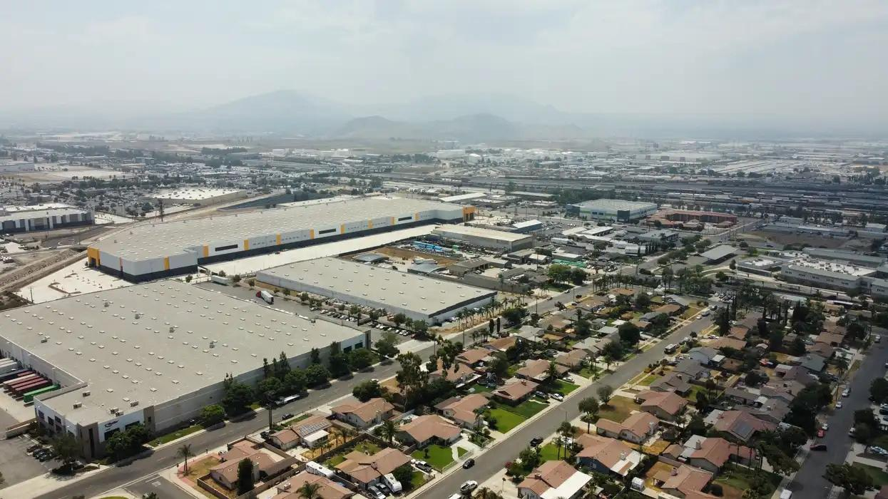

EVANGELICA ALCANTARA
RIVERSIDE CITY COLLEGE
STUDENT CLIMATE CONVERGENCE
Home
What We Do?
Solution
About
Growth at a Cost: Environmental Justice in the Inland Empire
An environmental justice perspective on health, development, and sustainability
30 May 2026
Credit: Jose Ramon Becerra Vera
Notes:
Good afternoon everyone, and thank you for being here today.
My name is Evangelica Alcantara, and today I’ll be discussing environmental justice in the Inland Empire, with a particular focus on:
warehouse expansion, air quality and community health
[pause]
Over the last several decades, the Inland Empire has transformed into one of the largest logistics and distribution hubs in the United States.
Warehouses, freight corridors, and e-commerce infrastructure have become deeply embedded within the region’s physical and economic landscape.
While this growth has created jobs and supported regional commerce, it has also introduced serious environmental and public health concerns that continue shaping everyday life for many residents.
[pause]
Today, I want to examine the Inland Empire not only as a center of economic development, but also as a space where environmental inequality becomes visible in everyday life.
Questions about air pollution are also questions about: land use, political decision making, public health, and whose communities absorb the environmental costs of economic growth.
[pause]
Throughout this presentation, I’ll explore: how warehouse expansion contributes to worsening air quality, how pollution exposure affects community health and why these issues connect to broader conversations about sustainability, equity and collective responsibility.
[slow down]
Ultimately, this presentation asks us to think critically about: who benefits from development and who bears its environmental costs.

Slide 2
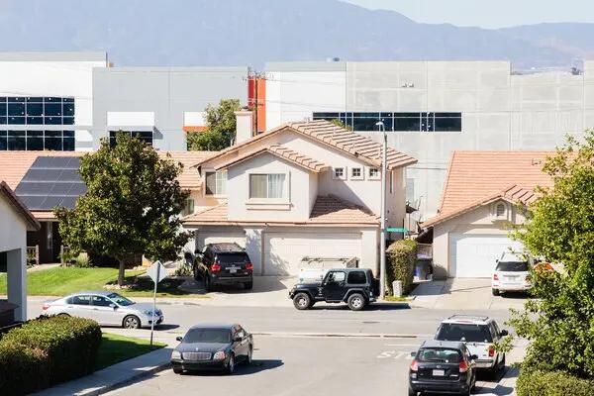

EVANGELICA ALCANTARA
RIVERSIDE CITY COLLEGE
STUDENT CLIMATE CONVERGENCE
Home
What We Do?
Solution
About
Credit: Alex Welsh/The New York Times
A Region Shaped by Logistics
FAST FACTS
  Severe Air Quality
  Expanding Warehouse Infrastructure
  Heavy Diesel Truck Traffic
  Unequal Community Health Burdens
Source: American Lung Association
Growth for whom? And at what cost?
Fast shipping comes with hidden consequences.
Notes:
To understand the environmental challenges facing the Inland Empire today, it’s important to first understand how the region became so heavily dependent on logistics and warehousing.
[pause]
The Inland Empire’s location made it ideal for large-scale distribution networks.
Its proximity to: the Ports of Los Angeles and Long Beach, major freeway systems, rail infrastructure, and relatively lower land costs attracted rapid industrial development over time.
As e-commerce expanded, companies increasingly relied on massive warehouse facilities capable of moving goods quickly across Southern California and beyond.
This transformed the Inland Empire into a critical part of national supply chains.
[pause]
Today, the transportation, distribution, and logistics sector — often referred to as TDL — is now:
the primary source of jobs in San Bernardino County and the second largest employer in Riverside County.
The rapid expansion of logistics has undeniably reshaped the regional economy and created major employment growth throughout the Inland Empire.
However, researchers at the University of California, Riverside also note that this growth has been accompanied by: widening wage inequality, labor insecurity, and growing environmental health concerns.
[pause]
This creates an important tension at the center of the region’s development: the same industry driving economic growth is also contributing to many of the environmental and social issues communities are now confronting.
[looks at audience]
This reflects an important sociological idea: Development is never purely economic.
It also shapes: how space is organized, which communities experience environmental burdens, and whose quality of life becomes affected by industrial expansion.

Slide 3

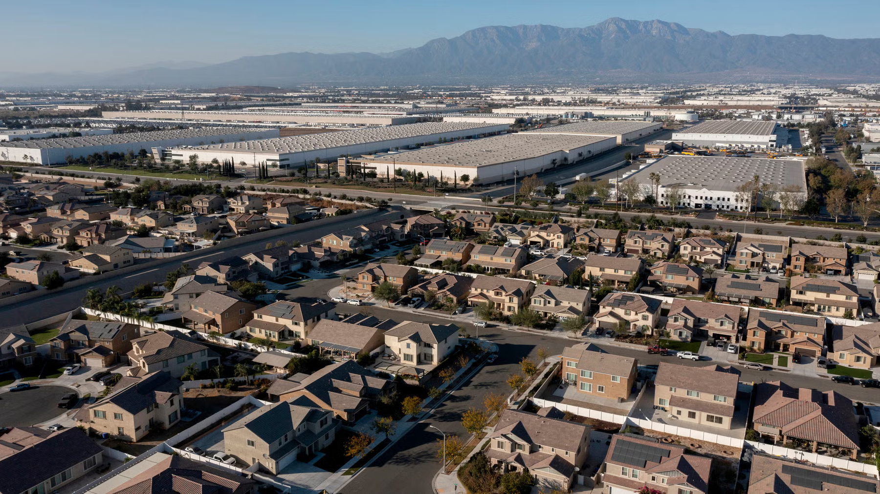
EVANGELICA ALCANTARA
RIVERSIDE CITY COLLEGE
STUDENT CLIMATE CONVERGENCE
Home
What We Do?
Solution
About
One of the Nation’s Worst Air Quality Regions
Credit: MattGush / Getty Images
According to the American Lung Association’s 2026 State of Air Report:
  San Bernardino: #1 for Smog
  Riverside: #2 for Smog
  26 Consecutive Years Ranked Worst
  100+ Unhealthy Smog Days
Notes:
The environmental consequences of this development are reflected clearly in regional air quality data.
According to the American Lung Association’s 2026 State of the Air report, Riverside and San Bernardino counties continue ranking among the worst regions in the nation for ozone pollution, commonly referred to as smog.
[pause]
What makes these rankings significant is their persistence.
This is not a temporary environmental event.
Poor air quality has become a long-standing condition throughout much of the Inland Empire.
Over time, repeated exposure becomes normalized.
Residents adapt to unhealthy environmental conditions because those conditions become woven into everyday life.
[slow down]
In sociological terms, environmental risk becomes spatially concentrated and socially normalized within particular communities.
This normalization matters because environmental inequality is often easier to ignore when it becomes routine.

Slide 4
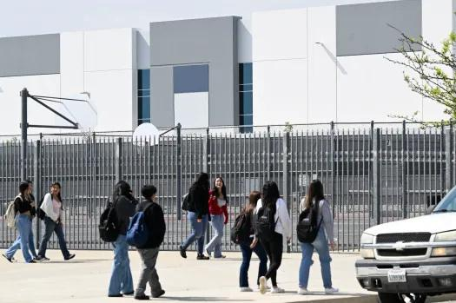

EVANGELICA ALCANTARA
RIVERSIDE CITY COLLEGE
STUDENT CLIMATE CONVERGENCE
Home
What We Do?
Solution
About
Communities Most Vulnerable
to Air Pollution
Children & Older Adults
Low-Income Communities
Communities of Color
People With Respiratory & Cardiovascular Conditions
Pregnant Individuals
Credit: The Press Enterprise
Notes:
Although poor air quality affects the entire region, environmental exposure does not affect all residents equally.
[pause]
Children…older adults…individuals with respiratory or cardiovascular conditions…and many low-income communities often face greater health risks from pollution exposure.
Children are especially vulnerable because their lungs are still developing, while older adults may already face underlying health conditions that become intensified through poor air quality.
[pause]
At the same time, vulnerability is not determined only by biology. Social and economic conditions also shape how environmental harm is experienced.
Communities with fewer economic resources often have: less access to healthcare, fewer opportunities to relocate away from industrial areas, and less political influence in development decisions affecting their neighborhoods.
Because of this, environmental inequality is not simply about pollution itself. It is also about unequal access to: protection, resources, and decision-making power.
[transition]
The next chart helps illustrate how these social and health vulnerabilities appear across the inland empire.

Slide 5
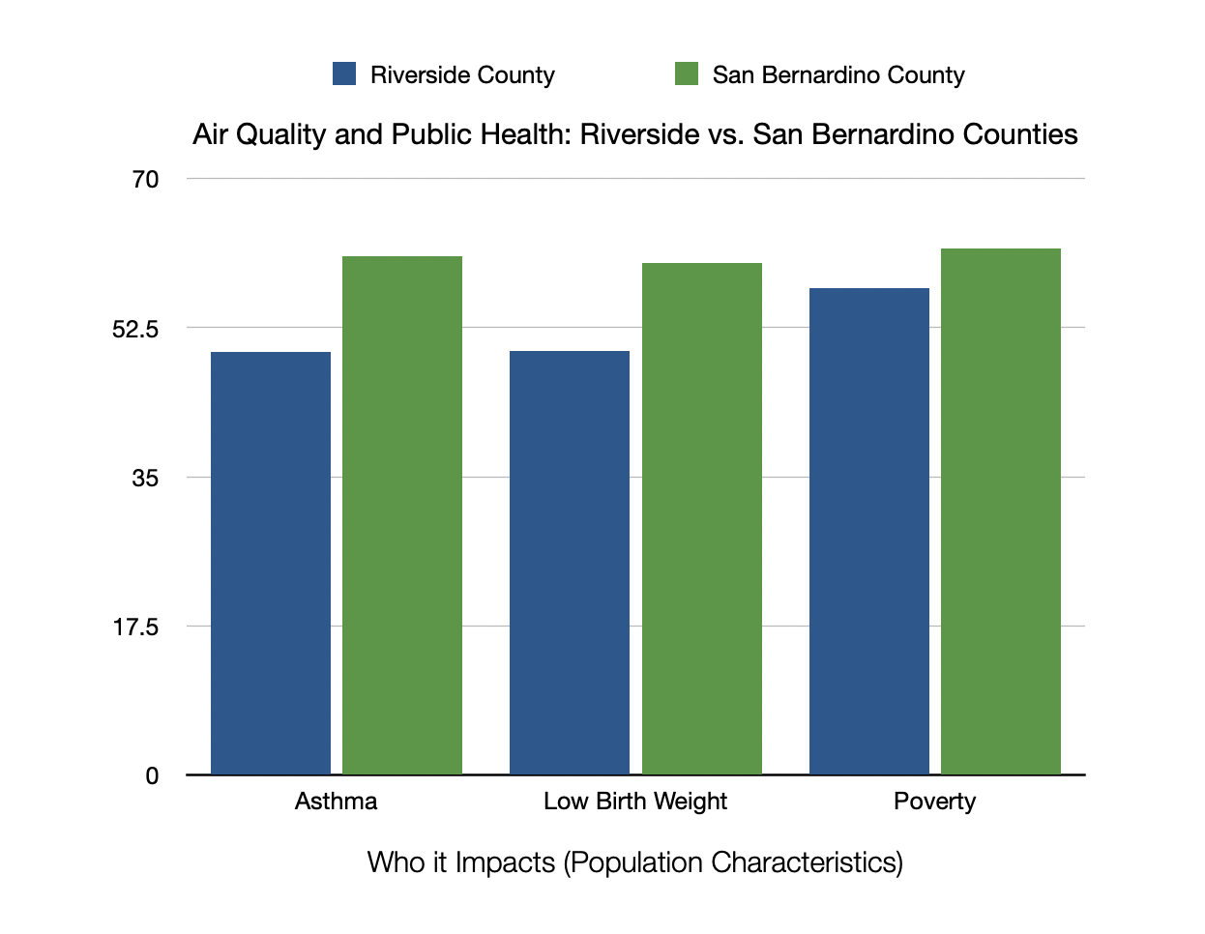
EVANGELICA ALCANTARA
RIVERSIDE CITY COLLEGE
STUDENT CLIMATE CONVERGENCE
Home
What We Do?
Solution
About
Credit: KTLA
Data from California Environmental Protection Agency, OEHHA. CalEnviroScreen 4.0 Report and Data (2021).
Notes:
While air pollution affects the Inland Empire broadly, CalEnviroScreen data helps illustrate how environmental burden overlaps with social and health vulnerability across the region.
This chart compares Riverside and San Bernardino counties using several population-based indicators, including asthma rates, low birth weight, and poverty levels. The percentile rankings reflect how each county compares to the rest of California, with higher percentiles indicating greater vulnerability.
[pause]
In Riverside County, asthma ranks at approximately the 50th percentile statewide, low birth weight also ranks near the 50th percentile, and poverty ranks at roughly the 57th percentile.
San Bernardino County ranks even higher across all three categories, with asthma at roughly the 61st percentile, low birth weight at the 60th percentile, and poverty near the 62nd percentile statewide.
What’s important about this data is not simply the numbers themselves, but the broader pattern they reveal…. Environmental burden and social vulnerability often overlap geographically rather than occurring separately.
Communities facing higher pollution exposure are also more likely to experience existing health and economic stressors, including respiratory illness and poverty.
[slow down]
From a sociological perspective, this reflects the concept of cumulative disadvantage, where multiple forms of inequality reinforce one another over time.
This helps shift the conversation away from the idea that pollution affects everyone equally… Instead, environmental risk becomes tied to broader social conditions, including healthcare access, housing patterns, economic inequality, and long-term community investment.
Understanding these overlapping vulnerabilities is essential to understanding why environmental justice is not only an environmental issue, but also a public health and social equity issue.

Slide 6
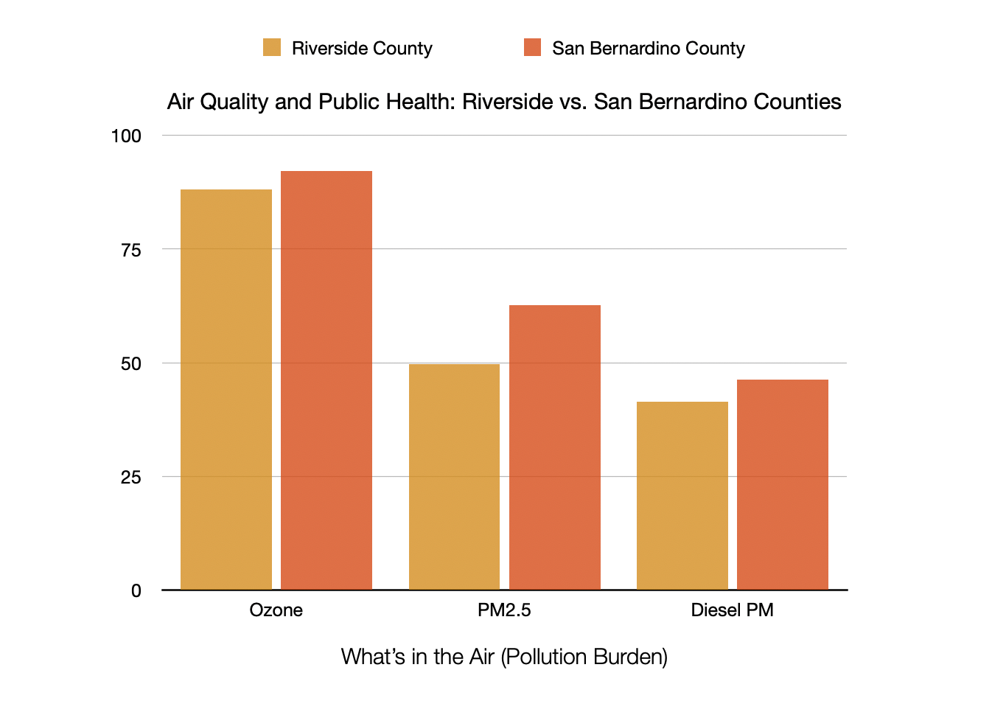
EVANGELICA ALCANTARA
RIVERSIDE CITY COLLEGE
STUDENT CLIMATE CONVERGENCE
Home
What We Do?
Solution
About
Credit: KTLA
Data from California Environmental Protection Agency, OEHHA. CalEnviroScreen 4.0 Report and Data (2021).
Notes:
To better understand air quality in the Inland Empire, it’s important to look more closely at the specific pollutants affecting the region and how these counties compare to the rest of California.
[looks at chart]
This chart uses CalEnviroScreen data to show pollution burden percentile rankings for Riverside and San Bernardino counties across three major pollution indicators: ozone pollution, PM2.5, and diesel particulate matter.
[pause]
Ozone, commonly referred to as smog, forms through emissions from vehicles and industrial activity reacting with sunlight.
It acts as a lung irritant and contributes to breathing difficulties… inflammation… and reduced lung function.
Both counties rank extremely high statewide for ozone pollution, with Riverside County ranking at approximately the 88th percentile and San Bernardino County exceeding the 92nd percentile. These rankings reflect how persistent and severe smog exposure remains throughout the region.
The chart also highlights PM2.5, or fine particulate matter. These microscopic airborne particles are commonly linked to diesel truck traffic, industrial activity, and wildfire smoke. Because these particles are so small, they can travel deep into the lungs and even enter the bloodstream.
San Bernardino County ranks above the 62nd percentile statewide for PM2.5 exposure, while Riverside County ranks near the 50th percentile. Diesel particulate matter also remains elevated across both counties, reflecting the region’s heavy concentration of freight movement and warehouse-related truck traffic.
[pause]
What makes these pollutants especially concerning is not simply their presence, but the frequency and duration of exposure. Many Inland Empire residents are not experiencing isolated pollution events.
Instead, exposure becomes part of everyday life through repeated contact with unhealthy air over long periods of time.
[slow down]
From a sociological perspective, this also reflects how environmental conditions become tied to regional economic systems. The same infrastructure supporting rapid delivery, consumer convenience, and economic growth also produces environmental burdens that become concentrated within local communities.

Slide 7

EVANGELICA ALCANTARA
RIVERSIDE CITY COLLEGE
STUDENT CLIMATE CONVERGENCE
Home
What We Do?
Solution
About
Credit: United States Environmental Protection Agency

Slide 8
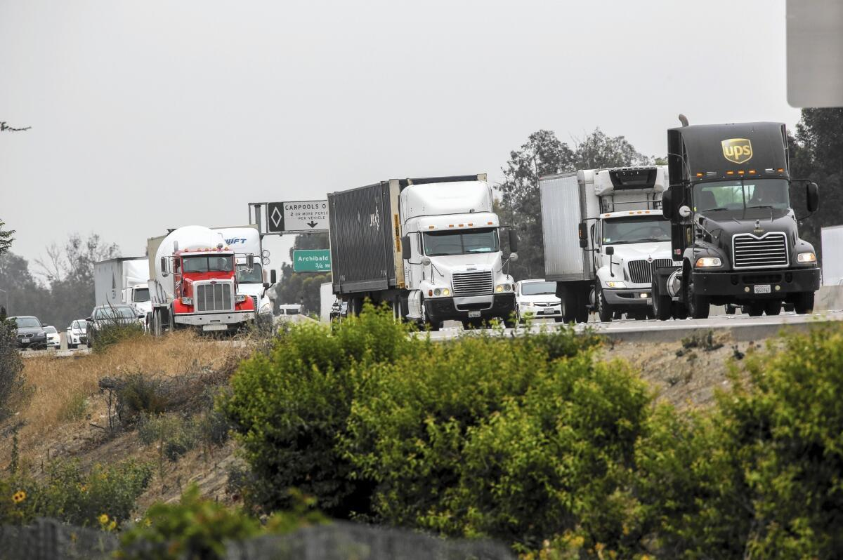
EVANGELICA ALCANTARA
RIVERSIDE CITY COLLEGE
STUDENT CLIMATE CONVERGENCE
Home
What We Do?
Solution
About
Air Pollution
& Community Health
Short term effects
Long term effects
  Asthma Attacks
  Breathing Difficulties
  Increased ER Visits
  Chronic Respiratory Disease
  Heart Disease & Stroke
  Reduced Lung Development
Exposure is not experienced equally.
Credit: Los Angeles Times
Notes:
Air pollution affects community health both immediately and over time.
In the short term, polluted air can contribute to asthma attacks… lung irritation.. breathing difficulties… and increased emergency room visits.
These effects often become more severe during periods of high smog or wildfire activity.
[pause]
However, long-term exposure presents even greater concerns.
Research has linked chronic pollution exposure to respiratory disease… cardiovascular illness…reduced lung development in children…and premature death.
Researchers studying warehouse concentration within the South Coast Air Basin found that more than 640 schools are located within a half-mile radius of warehouses.
This is especially concerning because children are particularly vulnerable to air pollution due to ongoing lung development and repeated long-term exposure during critical developmental years.
[pause]
What makes this significant is that environmental exposure becomes embedded into spaces typically associated with safety, education, and community wellbeing.
This also reflects the sociological concept of cumulative disadvantage. Communities already facing economic hardship, limited healthcare access, or housing insecurity may simultaneously experience greater environmental exposure.
As a result, environmental burdens can intensify existing inequalities rather than operate separately from them.

Slide 9
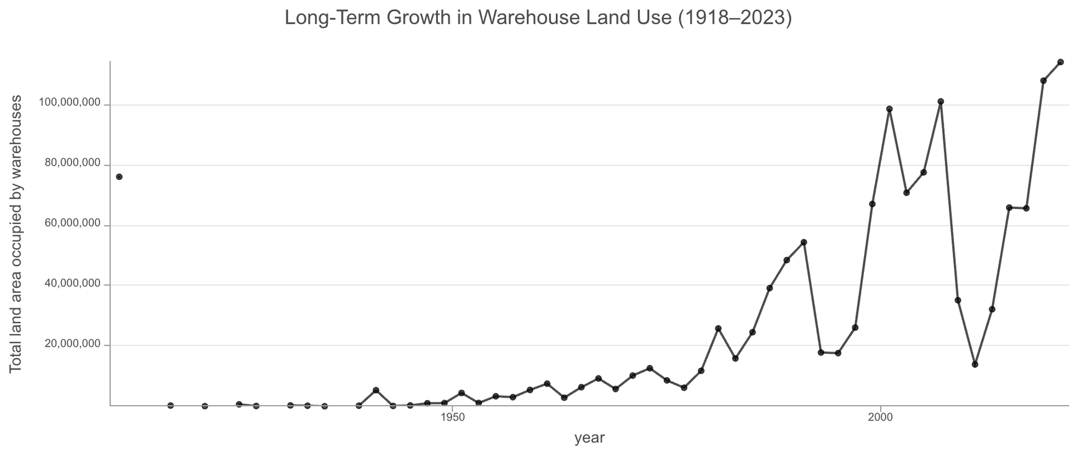
EVANGELICA ALCANTARA
RIVERSIDE CITY COLLEGE
STUDENT CLIMATE CONVERGENCE
Home
What We Do?
Solution
About
The Rapid Expansion of Warehousing
Warehouse land use expanded dramatically after the late 20th century.
Notes:
This chart illustrates the dramatic expansion of warehouse development across the Inland Empire over time.
For much of the early twentieth century, warehouse land use remained relatively limited.
However, beginning in the late twentieth century — and accelerating rapidly into the 2000s — warehouse development expanded at an extraordinary pace.
[pause]
According to the report published by UCR's Inland Empire Labor and Community Center, titled, The State of Work: Transportation, Distribution, and Logistics in the Inland Empire: As of 2023, the Inland Empire contained approximately 1 billion square feet of warehouse space — equivalent to more than 17,000 football fields — with an additional 170 million square feet still awaiting approval.
Researchers estimate that this continued expansion could increase regional toxic emissions by another 10%, illustrating how future development decisions will continue shaping environmental conditions across the region.
[pause]
As we move through the map progression, we can see how logistics infrastructure gradually spread throughout the region.
Areas that once contained less industrial development became increasingly dominated by warehouses and freight activity.
What’s important here is not simply the scale of growth, but the way this growth reorganized physical space throughout the region.
Land-use decisions shape environmental conditions over long periods of time. Once industrial infrastructure becomes concentrated within certain areas, surrounding communities often experience the environmental consequences for decades.
This helps illustrate how environmental inequality can become physically embedded into the landscape itself.

Slide 10
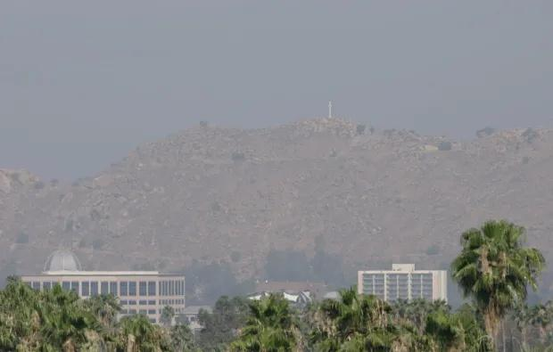
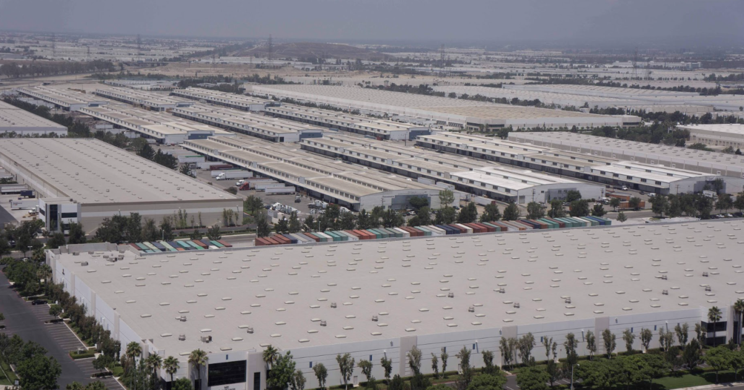
EVANGELICA ALCANTARA
RIVERSIDE CITY COLLEGE
STUDENT CLIMATE CONVERGENCE
Home
What We Do?
Solution
About
How Warehouse Expansion Shapes Air Quality
Diesel Truck Traffic
PM2.5 & Diesel Exhaust
Smog Formation
Residential Proximity
Long-Term Exposure
Credit: Jesse Lerner/Courtesy of Riverside Art Museum
Credit: The Press Enterprise
Notes:
Warehouse expansion affects air quality through several interconnected processes.
As warehouse development increases, diesel truck traffic also increases.
Thousands of trucks move through the Inland Empire daily transporting goods between ports, rail systems, warehouses, and retail distribution centers.
Diesel exhaust contributes heavily to PM2.5 pollution, while truck emissions and industrial activity also contribute to ozone formation.
[pause]
Researchers examining more than 3,300 warehouses within the South Coast Air Basin found that these facilities generate over 200 million diesel truck trips annually. Those trips produce more than 300,000 pounds of diesel particulate matter, 30 million pounds of nitrogen oxide, and billions of pounds of carbon dioxide every year.
These figures help demonstrate that warehouse expansion is not only a land-use issue, but also a large-scale environmental and public health issue tied directly to regional freight systems.
[pauses]
However, the issue is not only the existence of pollution, but the structure of exposure.
Many warehouses and freight corridors are located near residential neighborhoods, schools, and public spaces.
This means residents experience pollution repeatedly through everyday proximity rather than through isolated environmental incidents.

Slide 11
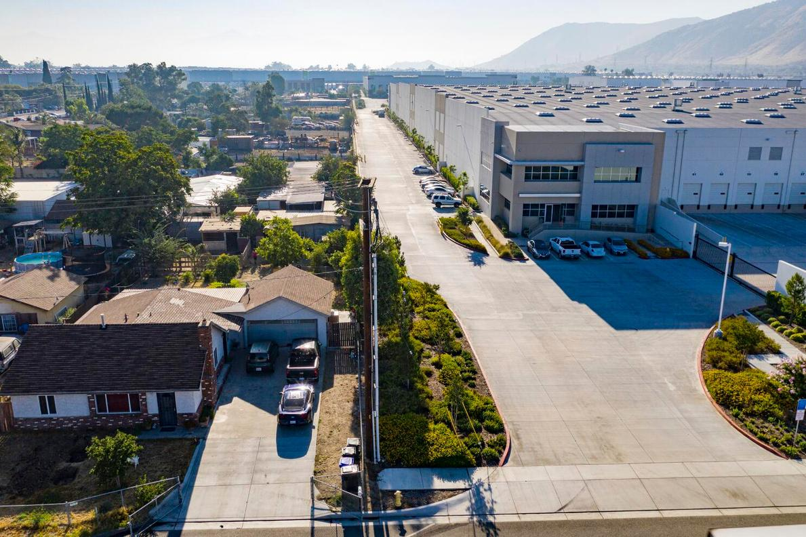
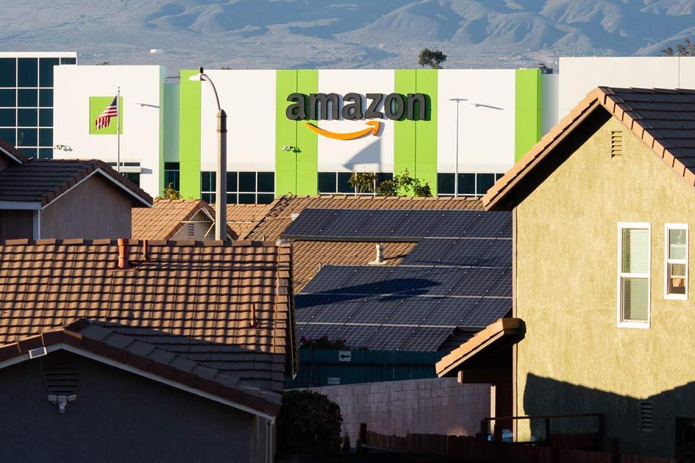
EVANGELICA ALCANTARA
RIVERSIDE CITY COLLEGE
STUDENT CLIMATE CONVERGENCE
Home
What We Do?
Solution
About
Why This Is an Environmental Justice Issue
Persistent Air Pollution
Vulnerable Populations
Long-Term Health Risks
Unequal Exposure
Credit: Los Angeles Times
Credit: Alex Welsh/The Guardian
Notes:
Environmental justice asks us to examine how environmental harm is distributed across society.
The central question is not simply whether pollution exists, but why some communities are expected to absorb more of its consequences than others.
[pause]
In the Inland Empire, environmental exposure is closely tied to patterns of land use, housing, economic inequality, and political power.
Communities located near freight infrastructure often experience greater long-term exposure while also possessing fewer resources to resist unwanted development.
Researchers also found that Latino residents are disproportionately affected by warehouse concentration. In Riverside County, 61% of Latino residents live within 300 feet of a warehouse despite representing approximately 46% of the county population.
Similar patterns appear in San Bernardino County, where Latino residents make up roughly half of the population but account for 61% of residents living near warehouses.
[pauses]
These disparities illustrate how environmental inequality often overlaps with racial and economic inequality.
This reflects a broader sociological pattern sometimes referred to as environmental burden shifting, where the environmental costs of economic systems become concentrated within particular communities.

Slide 12
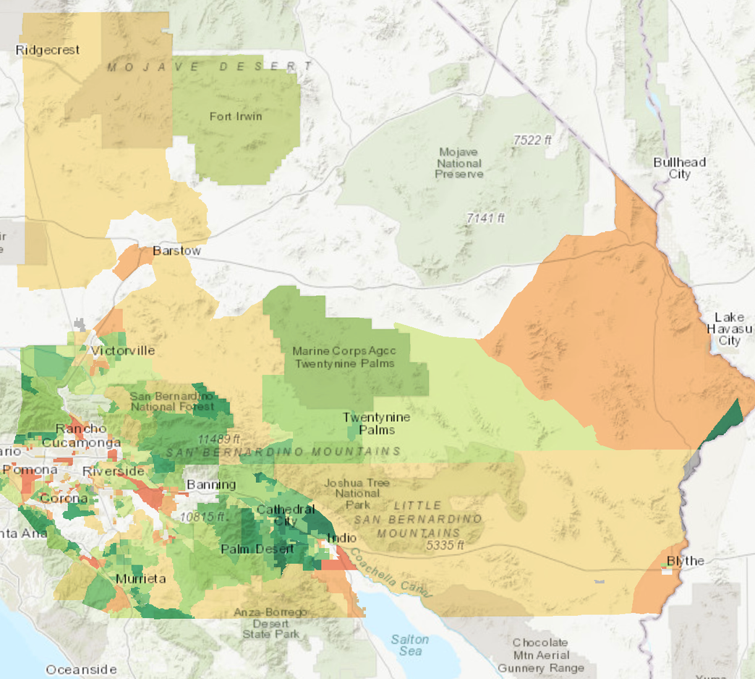
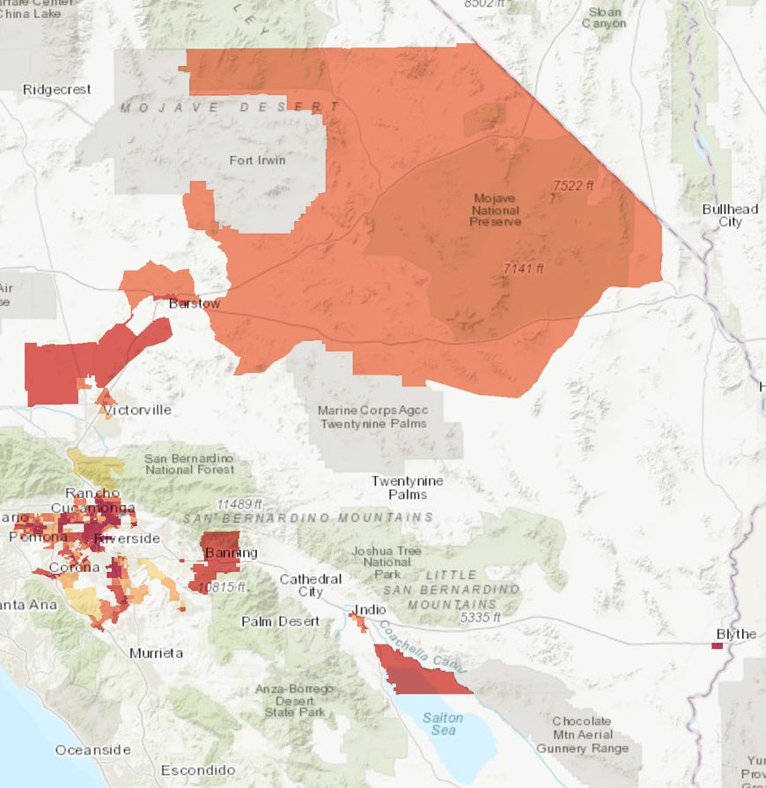
EVANGELICA ALCANTARA
RIVERSIDE CITY COLLEGE
STUDENT CLIMATE CONVERGENCE
Home
What We Do?
Solution
About
Pollution Burdens Are Unequally Distributed
Notes:
This map helps visualize those inequalities more clearly.
When comparing advantaged and disadvantaged communities throughout the Inland Empire, a clear pattern emerges: communities experiencing greater socioeconomic disadvantage also tend to experience higher pollution burdens.
Meanwhile, more affluent communities often experience lower levels of environmental exposure.
These patterns are not random. They reflect decades of development decisions, zoning practices, housing inequalities, and uneven political influence.
Environmental inequality becomes geographically organized, meaning certain communities repeatedly experience greater environmental risk based on where industrial development is concentrated.
The map makes visible how inequality can become physically embedded within regional landscapes.

Slide 13
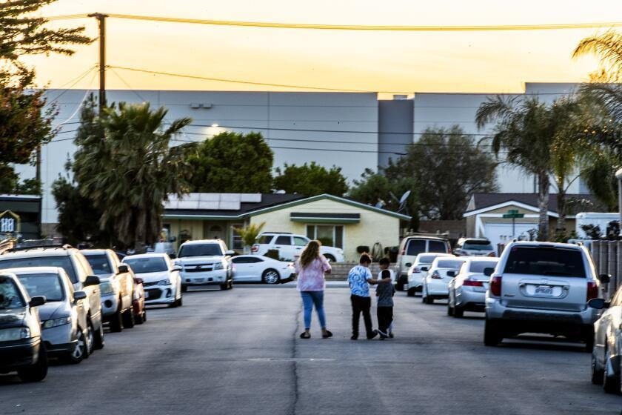
EVANGELICA ALCANTARA
RIVERSIDE CITY COLLEGE
STUDENT CLIMATE CONVERGENCE
Home
What We Do?
Solution
About
Credit: Los Angeles Times
Rethinking “Sustainability”
  Economic Growth
  Environmental Burden
  Unequal Exposure
  Public Health Costs
Not all development is sustainable
Especially when its impacts are unevenly disproporionate
Notes:
Warehouse expansion is often framed through the language of efficiency, economic growth, and regional development.
The logistics industry undeniably plays a major role in employment and commerce throughout Southern California.
However, environmental justice encourages us to think more critically about how sustainability is defined and who benefits most from economic growth.
[pause]
Despite the rapid expansion of the logistics economy, many warehouse and transportation workers continue receiving relatively low wages.
UCR researchers found that warehouse laborers, stockers, and order fillers earn median annual wages of approximately $25,000 per year, while packers and packagers earn closer to $23,000 annually.
This complicates the assumption that economic growth automatically produces widespread social wellbeing.
In many cases, the same communities supplying labor for the logistics economy are also absorbing its environmental and health burdens.
[slow down]
If economic growth depends on some communities experiencing environmental exposure, health risks, and economic insecurity simultaneously, can that system truly be considered sustainable?
LEAVE ROOM FOR DISCUSSION HERE

Slide 14
EVANGELICA ALCANTARA
RIVERSIDE CITY COLLEGE
STUDENT CLIMATE CONVERGENCE
Home
What We Do?
Solution
About
Let’s Discuss:
How should we define sustainability beyond economic growth alone?
Notes:
This chart illustrates the dramatic expansion of warehouse development across the Inland Empire over time.
For much of the early twentieth century, warehouse land use remained relatively limited.
However, beginning in the late twentieth century — and accelerating rapidly into the 2000s — warehouse development expanded at an extraordinary pace.
[pause]
According to the report published by UCR's Inland Empire Labor and Community Center, titled, The State of Work: Transportation, Distribution, and Logistics in the Inland Empire: As of 2023, the Inland Empire contained approximately 1 billion square feet of warehouse space — equivalent to more than 17,000 football fields — with an additional 170 million square feet still awaiting approval.
Researchers estimate that this continued expansion could increase regional toxic emissions by another 10%, illustrating how future development decisions will continue shaping environmental conditions across the region.
[pause]
As we move through the map progression, we can see how logistics infrastructure gradually spread throughout the region.
Areas that once contained less industrial development became increasingly dominated by warehouses and freight activity.
What’s important here is not simply the scale of growth, but the way this growth reorganized physical space throughout the region.
Land-use decisions shape environmental conditions over long periods of time. Once industrial infrastructure becomes concentrated within certain areas, surrounding communities often experience the environmental consequences for decades.
This helps illustrate how environmental inequality can become physically embedded into the landscape itself.

Slide 15
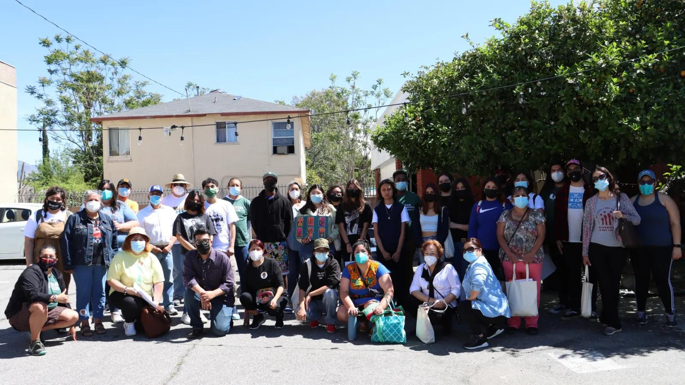
EVANGELICA ALCANTARA
RIVERSIDE CITY COLLEGE
STUDENT CLIMATE CONVERGENCE
Home
What We Do?
Solution
About
Education Beyond Workforce Preparation
Credit: The Press Enterprise
  Environmental Impact
  Equity & Justice
  Long-Term Sustainability
  Critical Thinking About Systems
Education should help students question and reshape systems.
Notes:
These conversations also connect closely to education.
Discussions about sustainability frequently emphasize preparing students for careers within emerging green and blue economy industries. Those opportunities are important, especially as societies transition toward new environmental and economic systems.
However, education also serves another purpose beyond workforce preparation alone.
Students should be encouraged not only to participate within systems, but also to critically evaluate how those systems shape communities, labor, health, and environmental conditions.
Addressing environmental justice requires more than technical solutions. It also requires critical thinking, civic engagement, and the ability to question how development decisions are made and whose interests those decisions prioritize.

Slide 16
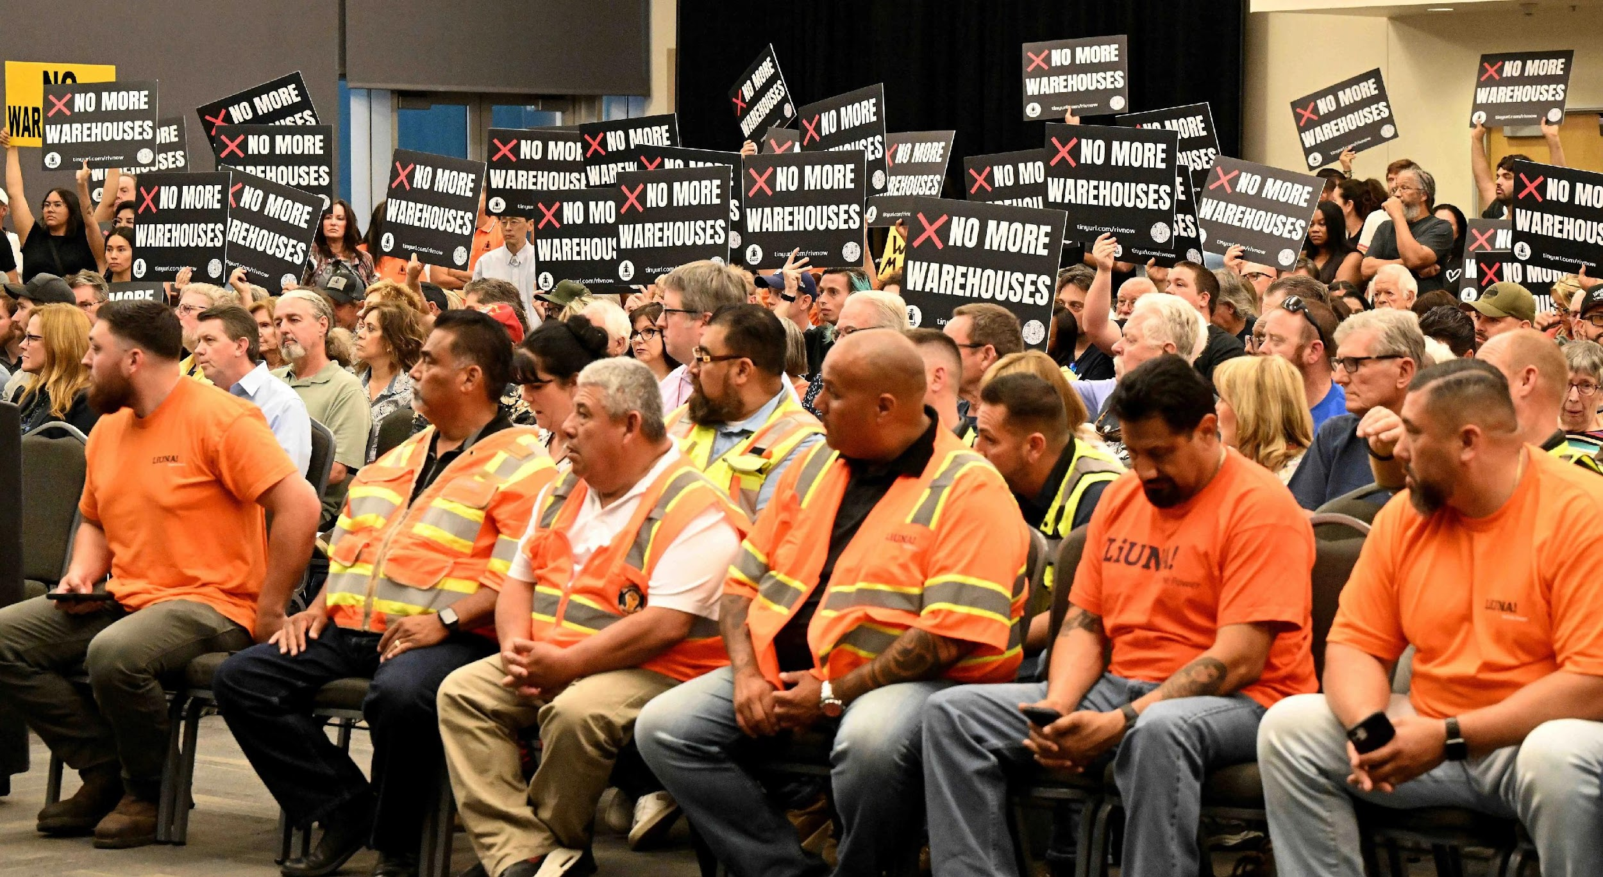
EVANGELICA ALCANTARA
RIVERSIDE CITY COLLEGE
STUDENT CLIMATE CONVERGENCE
Home
What We Do?
Solution
About
Community Advocacy & Environmental Justice
Grassroots Organizing
Health & Environmental Justice
Community-Led Advocacy
Policy & Development Pressure
Organizations like RNOW advocate for community-centered solutions.
Credit: The Press Enterprise
Notes:
Environmental justice work in the Inland Empire is also deeply community-driven.
Residents, organizers, and grassroots organizations have played a major role in bringing visibility to the environmental and health impacts of warehouse expansion throughout the region.
Much of this advocacy focuses on protecting frontline communities — neighborhoods experiencing repeated exposure due to their proximity to warehouses and freight infrastructure.
Organizations such as Riverside Neighbors Opposing Warehouses, or RNOW, have advocated for stronger environmental review processes, greater accountability in development decisions, and policies that prioritize public health alongside economic growth.
What’s important here is that communities are not simply passive recipients of environmental inequality. Residents actively organize, challenge development decisions, and push for alternative visions of sustainability and community health.

Slide 17
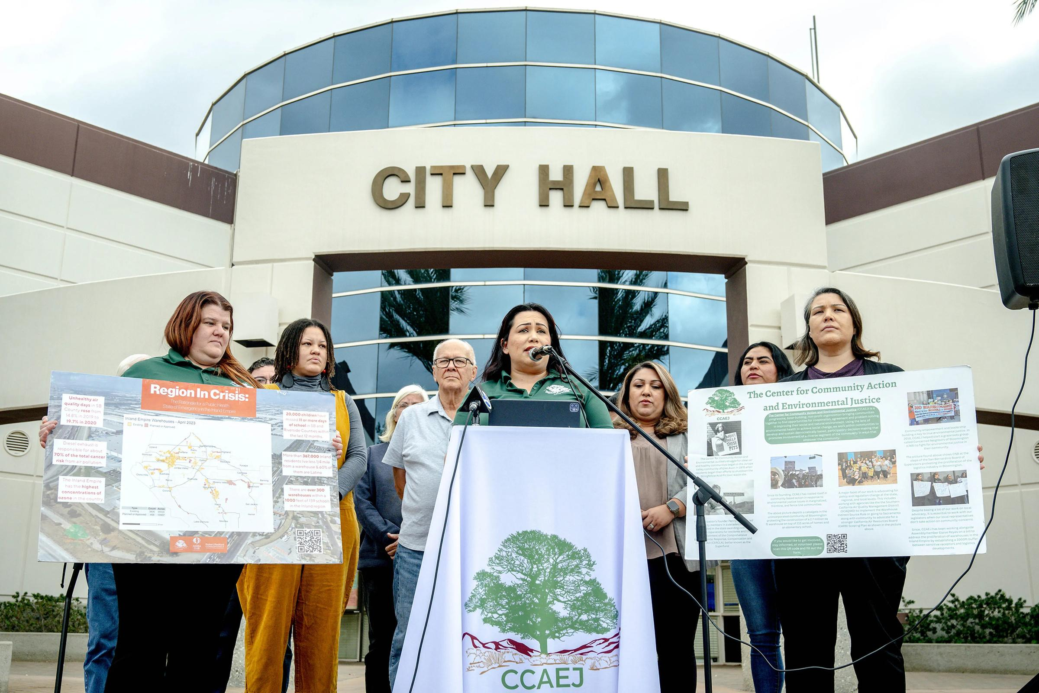
EVANGELICA ALCANTARA
RIVERSIDE CITY COLLEGE
STUDENT CLIMATE CONVERGENCE
Home
What We Do?
Solution
About
From Awareness
to Action
Critical Understanding
Community Engagement
Advocacy & Research
Questioning Systems
Education can become a tool for change
Credit: The Press Enterprise
Notes:
Awareness alone is not enough to address environmental injustice.
Understanding the relationship between warehouse expansion, air quality, and public health is an important first step, but meaningful change also requires engagement and collective action.
Community organizations, researchers, students, educators, and residents all play a role in shaping conversations about environmental responsibility and regional development.
Climate conversations often focus on large-scale global systems, but environmental justice reminds us that climate and sustainability issues are also deeply local. They affect neighborhoods, schools, public health, and the conditions people experience every day.
Addressing these challenges requires not only policy change, but also public participation, community advocacy, and continued critical engagement with how development occurs.

Slide 18
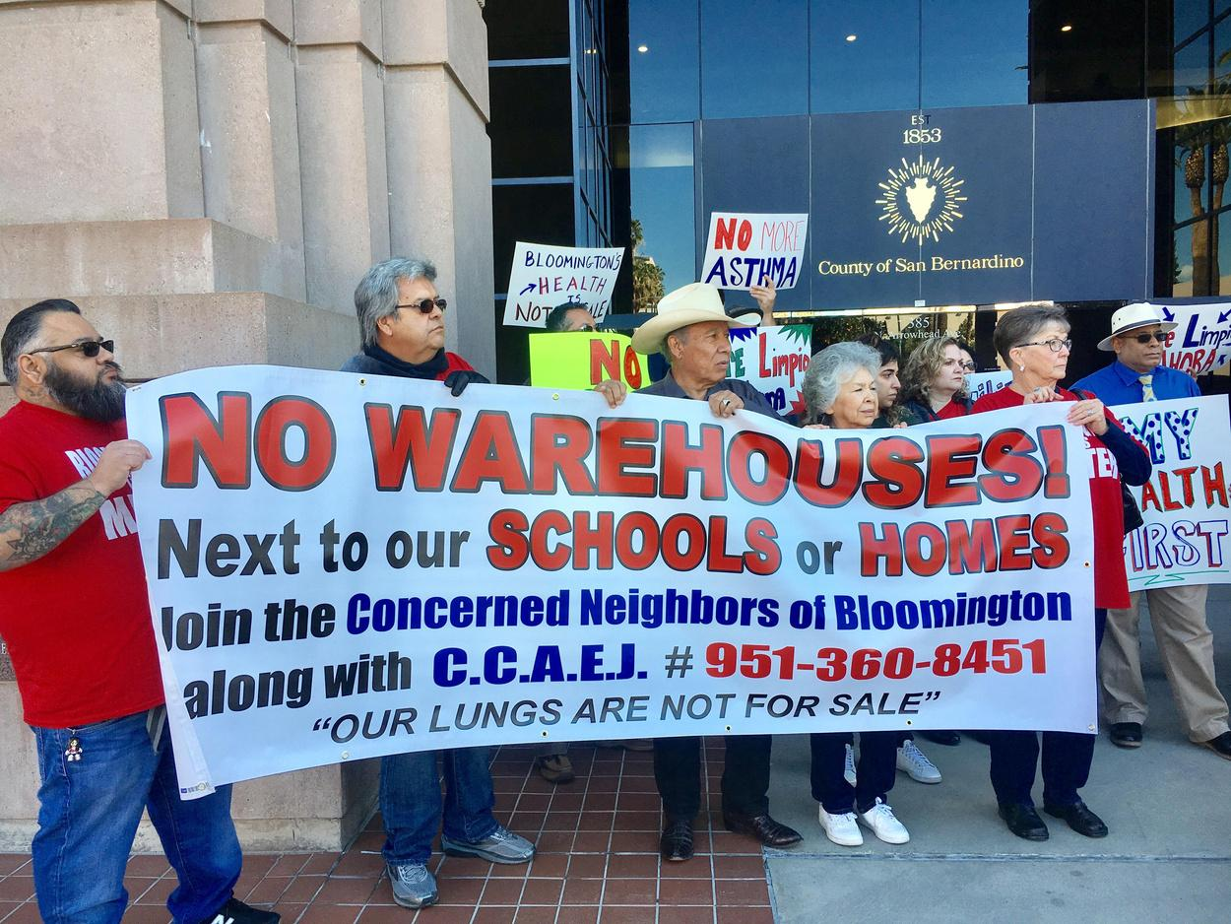
EVANGELICA ALCANTARA
RIVERSIDE CITY COLLEGE
STUDENT CLIMATE CONVERGENCE
Home
What We Do?
Solution
About
Clean air is a right shaped by collective responsibility and systemic change.
Credit: Anthony Victoria / Inland Empire Community News
Notes:
Environmental justice reminds us that environmental conditions are never experienced equally across society.
The Inland Empire demonstrates how the environmental costs of modern consumption and rapid delivery systems can become concentrated within particular communities over time.
Examining these patterns through an environmental justice lens allows us to see how inequality becomes physically embedded into the places where people live, work, and breathe.
Ultimately, conversations about sustainability must also be conversations about equity, health, and collective responsibility.

Slide 19
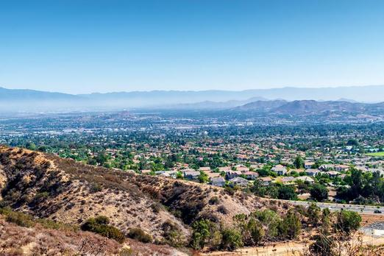
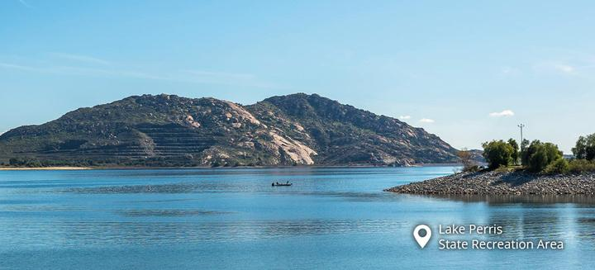
EVANGELICA ALCANTARA
RIVERSIDE CITY COLLEGE
STUDENT CLIMATE CONVERGENCE
Home
What We Do?
Solution
About
Thank you for taking the time to engage with this issue!
Environmental justice begins with awareness & continues with action.
Presented by
Evangelica Alcantara
Sociology / Law, Public Policy & Society
Questions? Email me at ealcantara2@student.rccd.edu
Credit: Tim Gray
Credit: Courtesy of California State Parks, 2026.
Notes:
Thank you all for your time and for engaging with this discussion today.
I appreciate the opportunity to share this work, and I hope this presentation encourages continued reflection on how environmental conditions, public health, development, and inequality intersect within the Inland Empire.
I’m happy to answer any questions or continue the conversation further.

